Slide 1
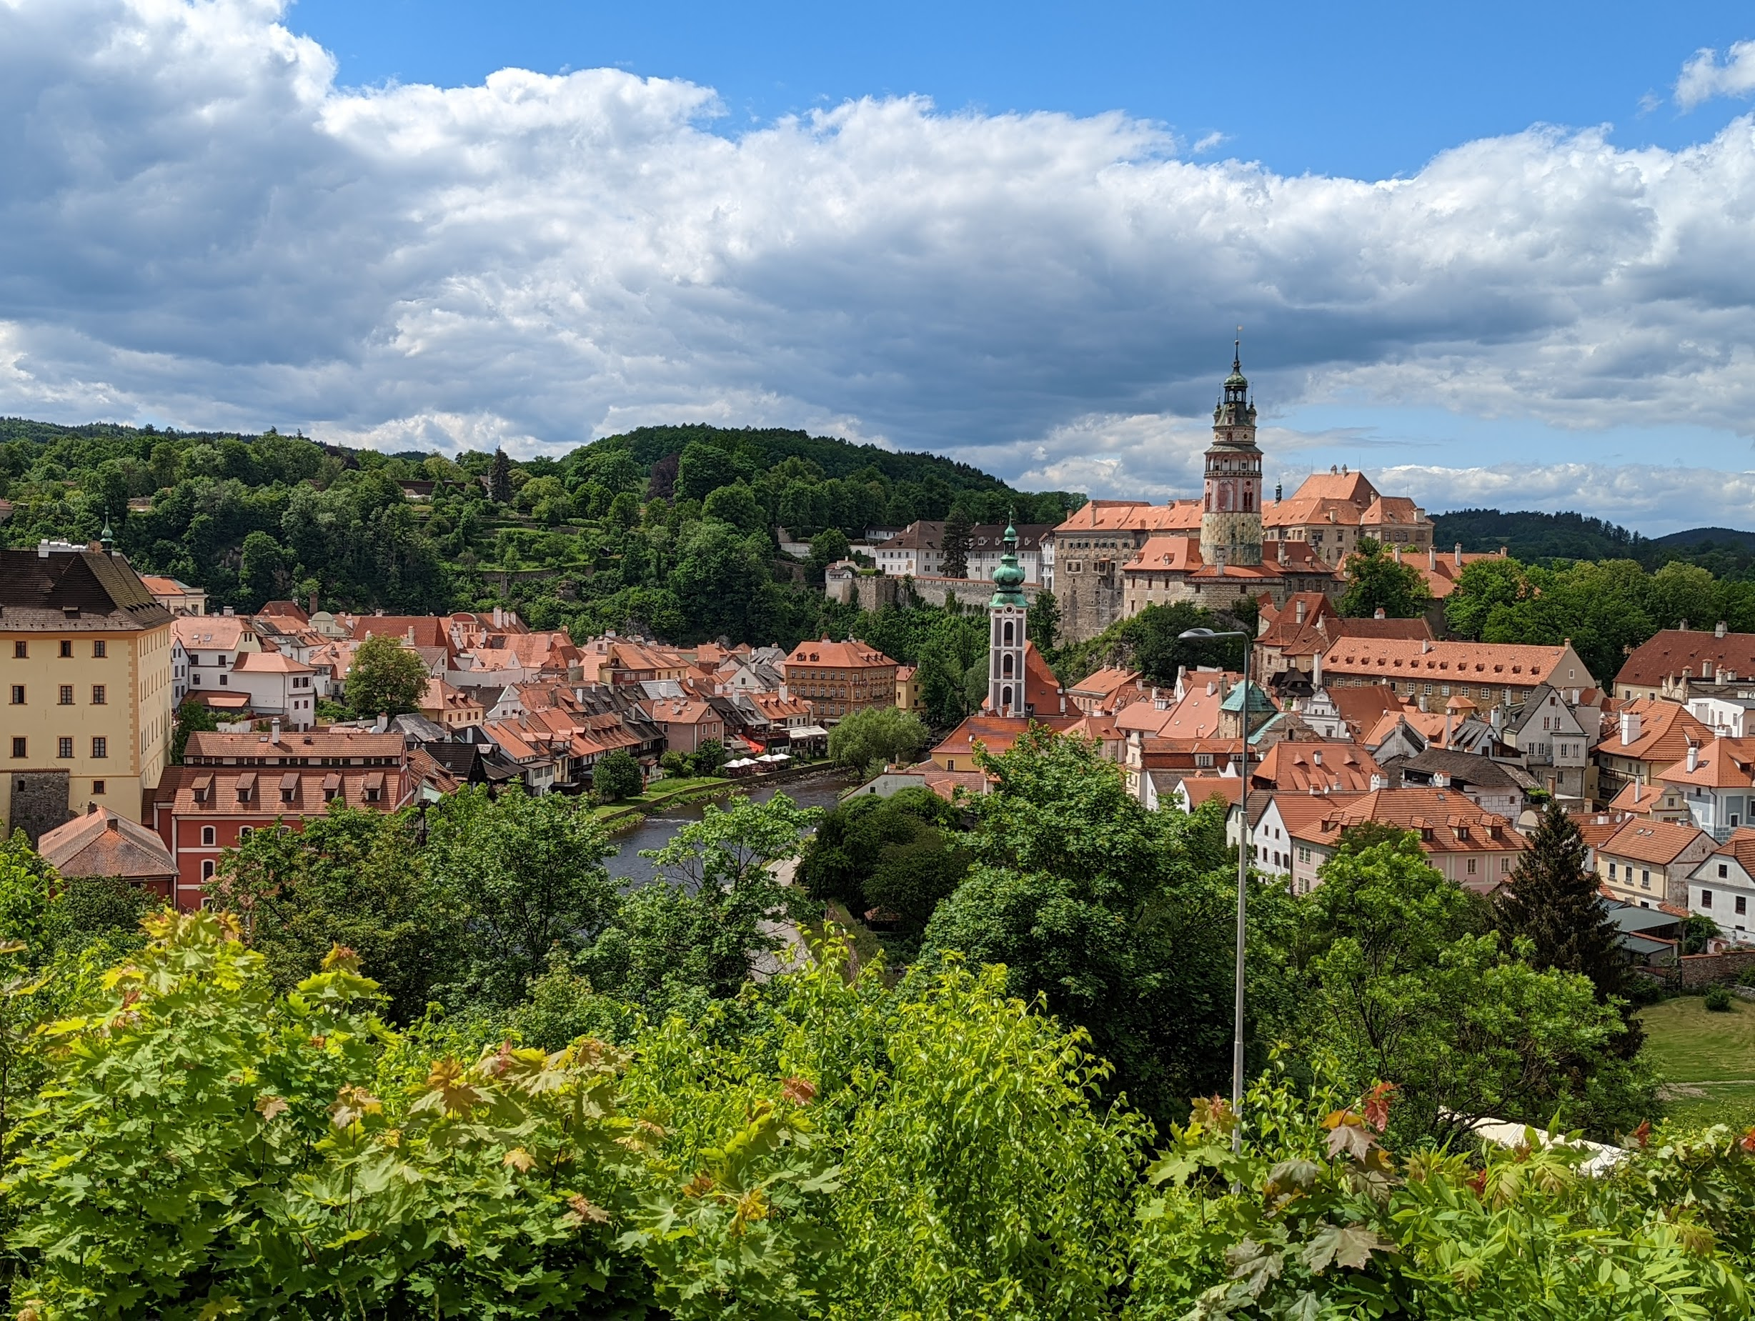
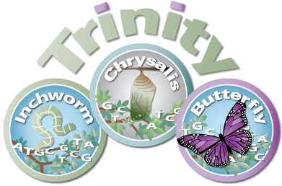
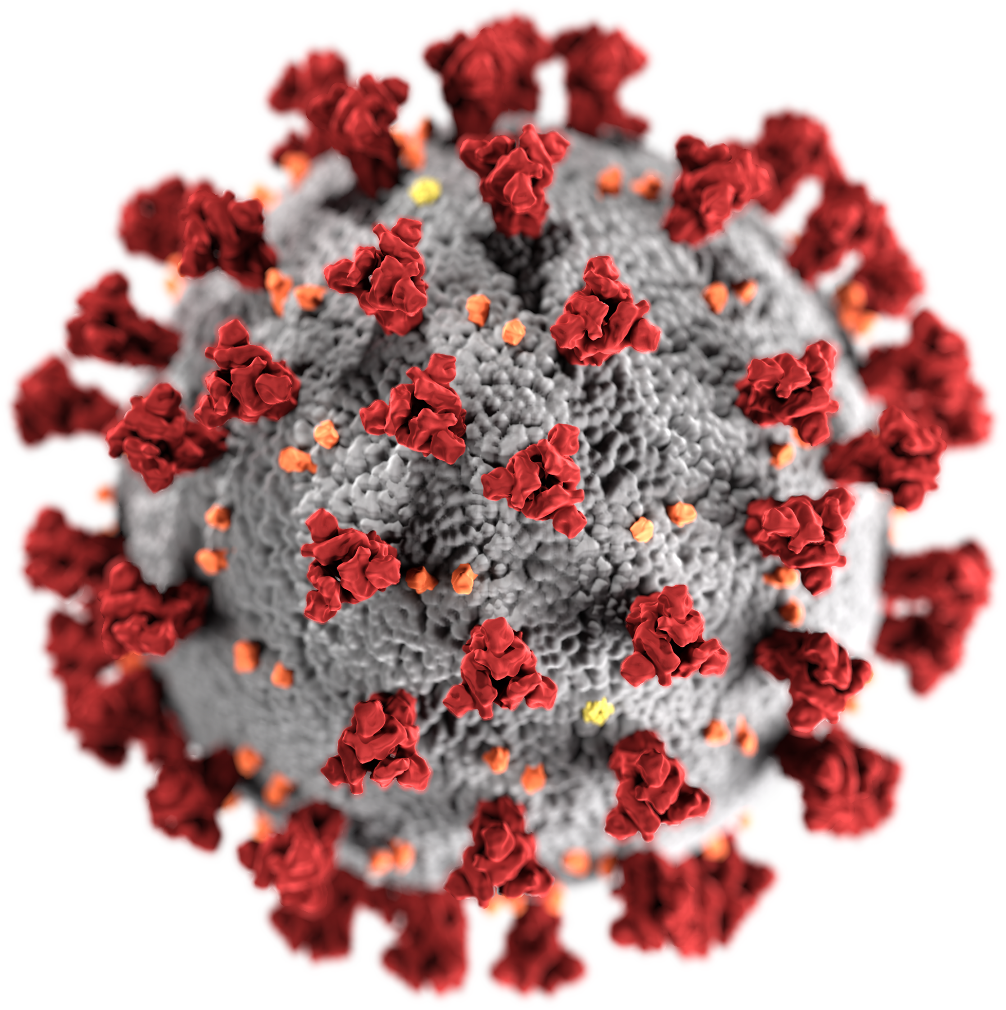
The Krumlov Trinity
Transcriptomics Experience
Brian Haas
Broad Institute
Workshop on Genomics, Cesky Krumlov, May 2022

Slide 2
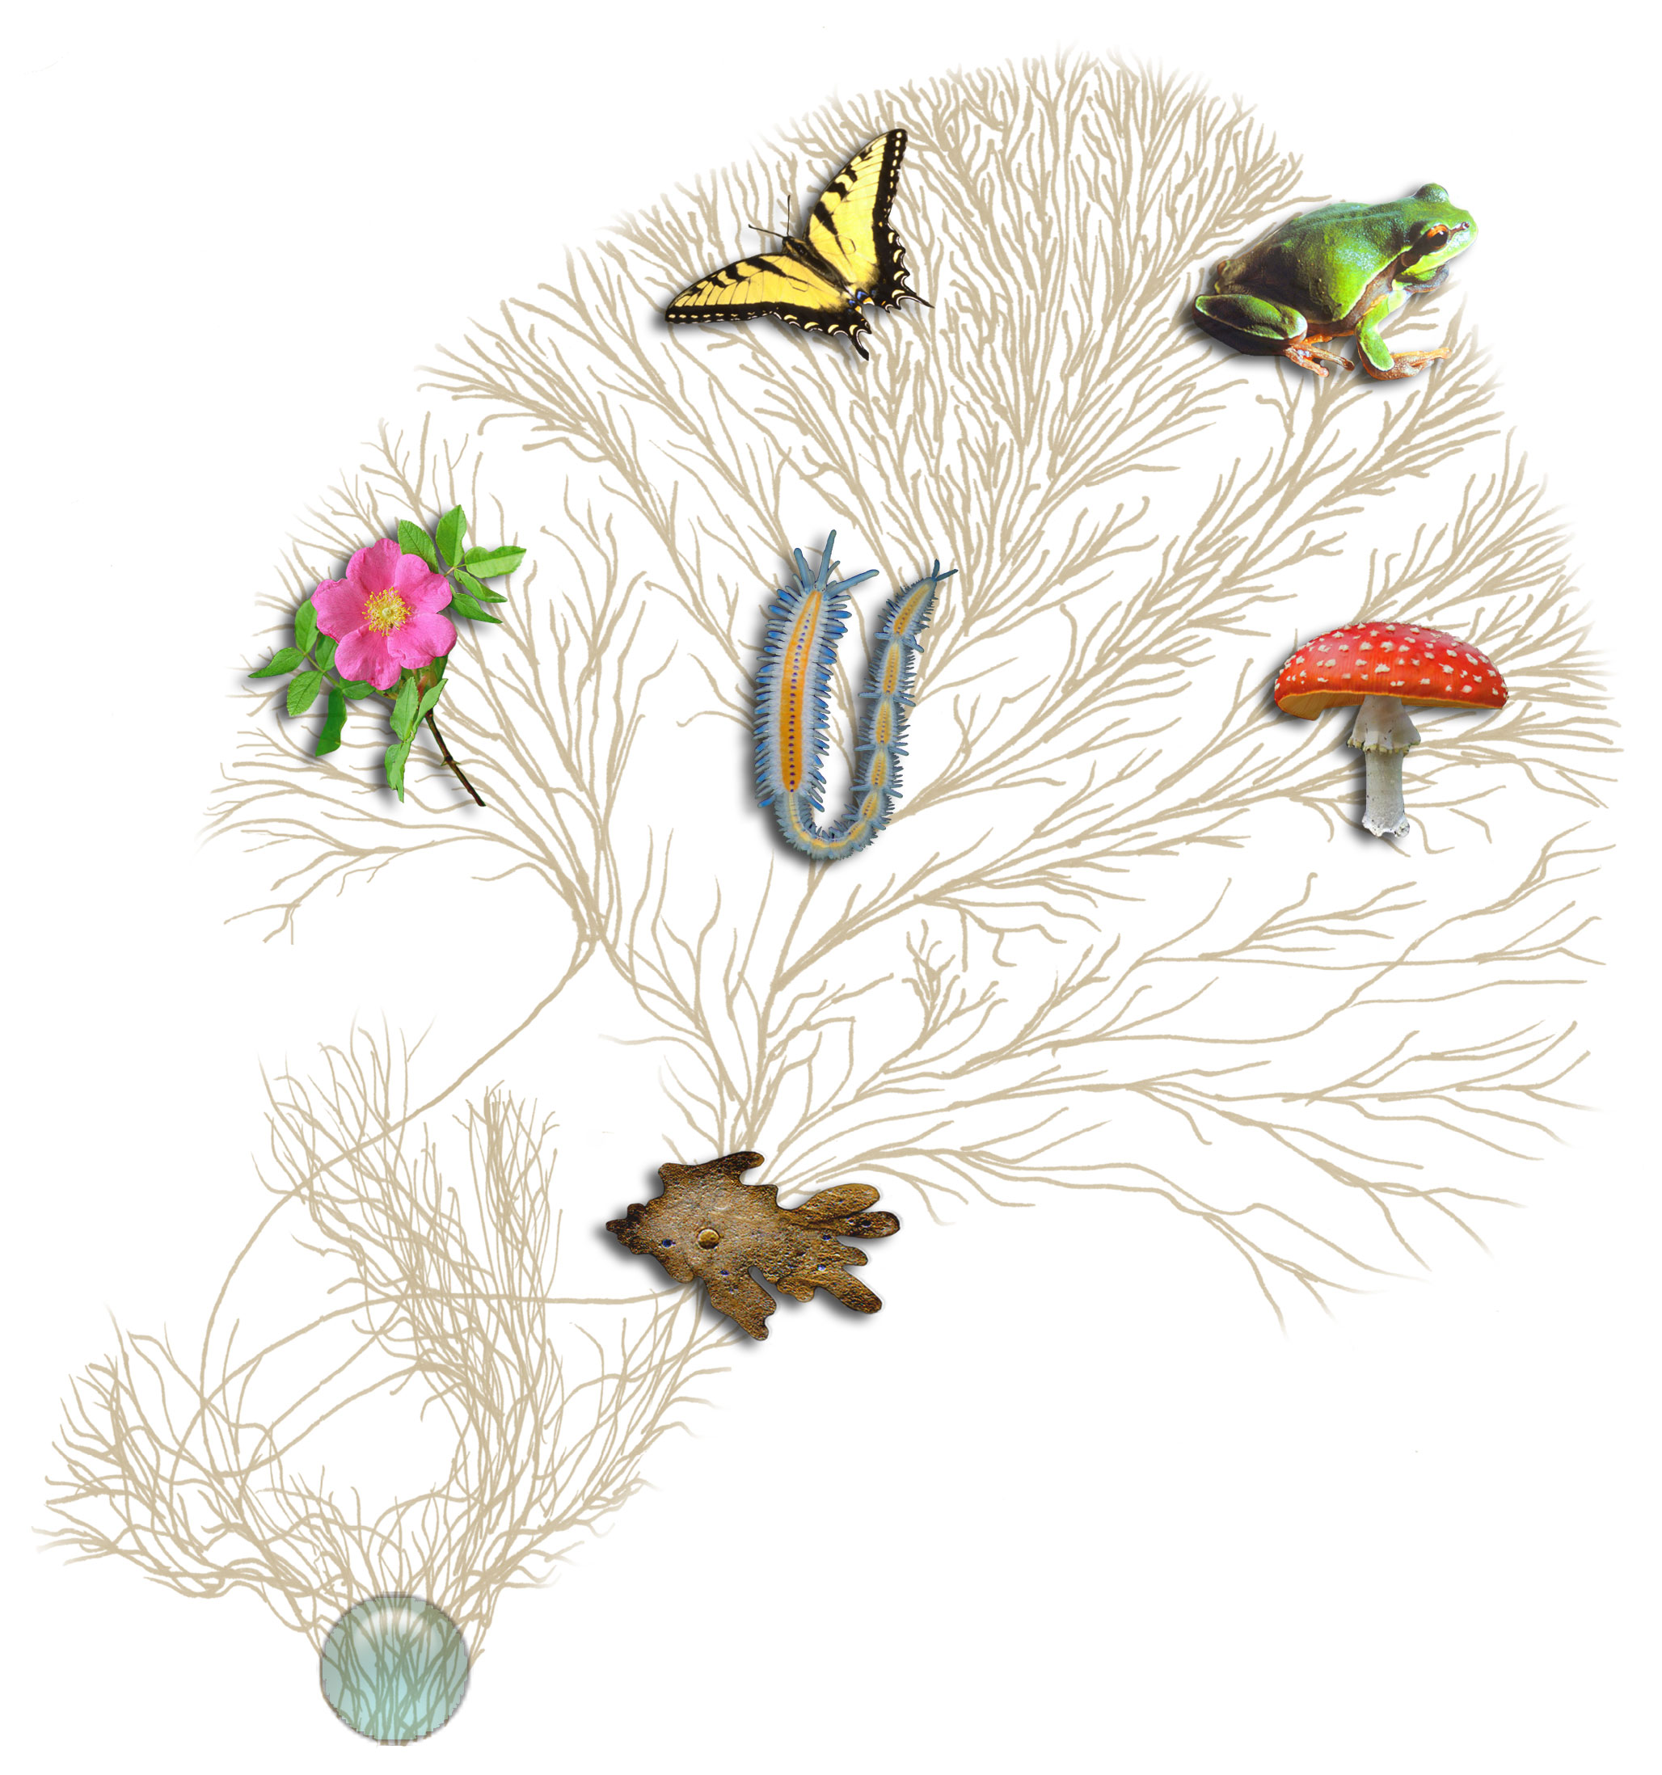
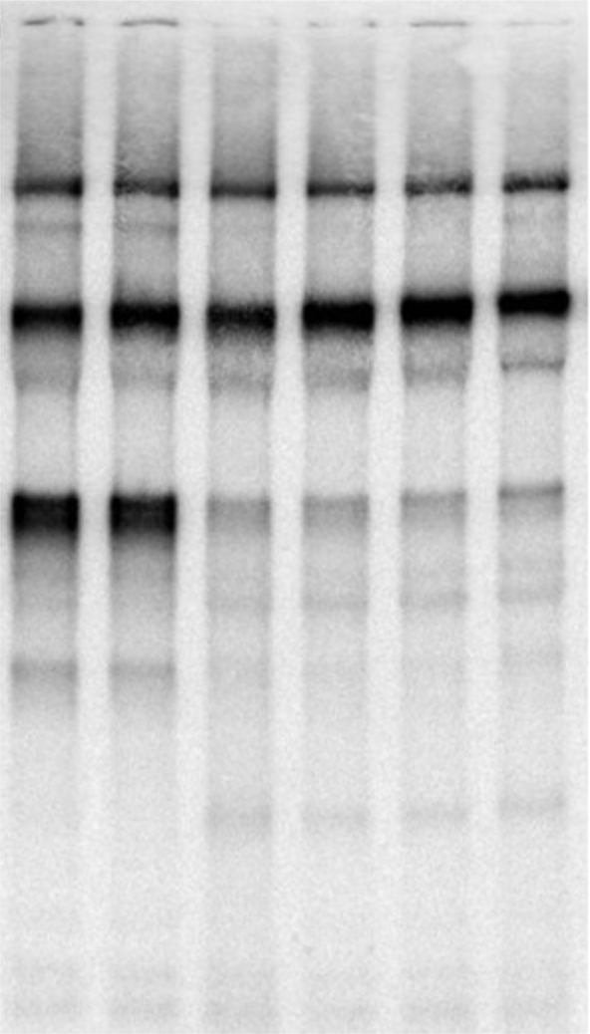
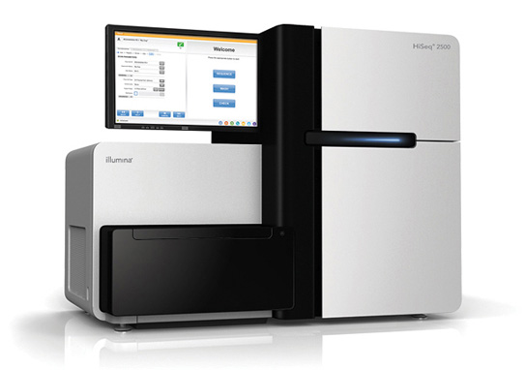
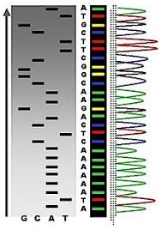
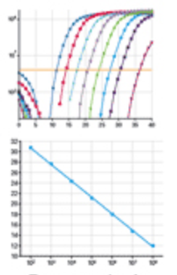
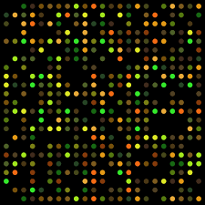
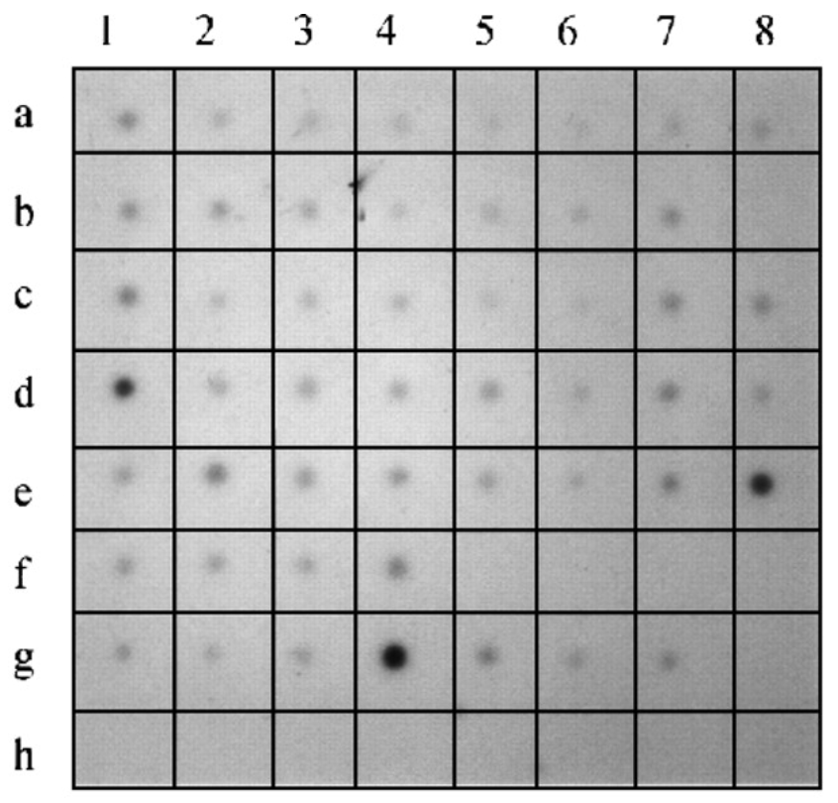
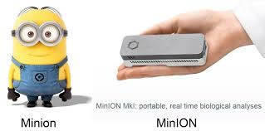
Biological Investigations Empowered by Transcriptomics
Extract RNA,
… some protocol for processing, ...
Northern
Analysis Method
(pick your favorite)
Other…
Microarray
Dot Blot
Sanger Sequencing
qRT-PCR
Notes:
Many biological investigations have been empowered by transcriptomics over the years.
Transcriptomics has historically involved extracting RNA from some living organism and then using some technology to study its various characteristics, such as quantifying expression or identifying its sequence
And the technology has changed dramatically over the years, from doing Northern blots with radioactive isotopes to microarrays, qRT-PCR, and the various advances in sequencing.

Slide 3
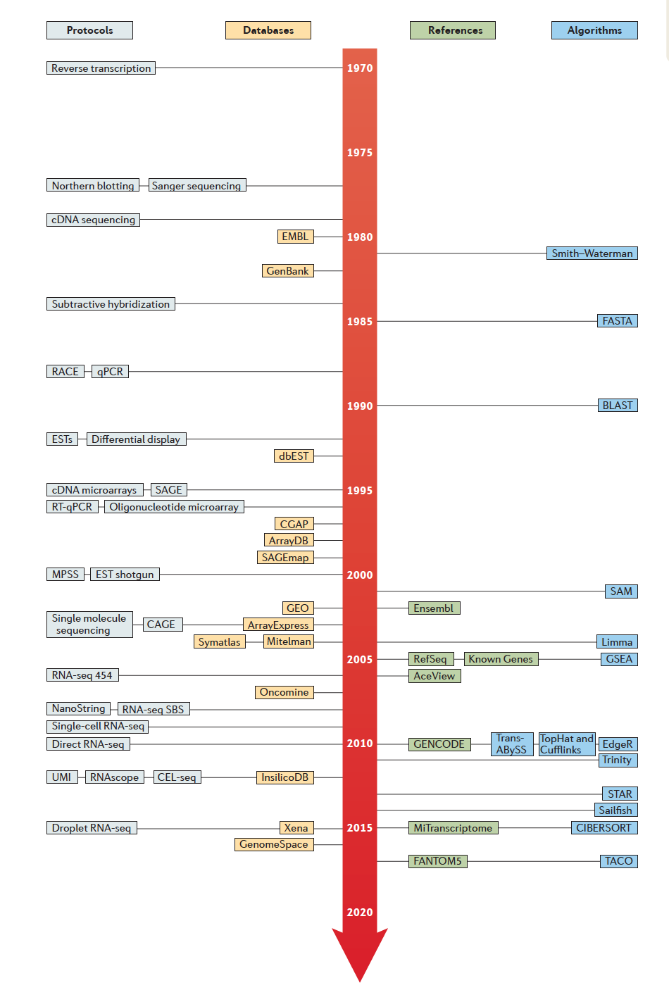
Historical Timeline to Modern Transcriptomics (from 1970)
Reverse Transcription (1970)
Note: Just a small sampling of what’s available.
Northern Blot
Sanger Sequencing
(1977)
Smith Waterman (1981)
BLAST (1990)
Expressed Sequence Tags (1992)
cDNA microarrays (1995)
Tophat/Cufflinks (2010)
RNA-Seq (2006-2008)
RSEM
(2011)
PacBio IsoSeq (2014)
Droplet single cell RNA-Seq (2015)
Direct RNA Seq Nanopore (2018)
Kallisto (2016)
Salmon (2017)
From Cieslik and Chinnaiyan,
NRG, 2017
Lots more!
Notes:
Advances in transcriptomics spanned developments in experimental protocols, sequence databases, and algorithms for analyzing these data, as shown in this timeline from a recent review paper in Nature Reviews Genetics.
I pulled out a few notable examples so you could better read them, and added a few of my own.
The discovery of reverse transcriptase in 1970 arguably kicked off most of the modern advancements. Almost all RNA methods commonly used today leverage reverse transcriptase as part of the protocol.
Some key developments involved EST sequencing in the early 1990’s, which led to the development of cDNA microarrays. It wasn’t until about 10 years later that massively parallel sequencing of RNAs was made possibly by innovations in next generation sequencing technologies.
Just a couple of years ago, droplet-based single cell rna-sequencing was developed, and less than 48 hours ago, Nature published a paper on direct sequencing of RNA via nanopore sequencings.
It’s a very exciting field and area of research, and it’s tightly coupled to advances in software tools for processing and analyzing these data.

Slide 4
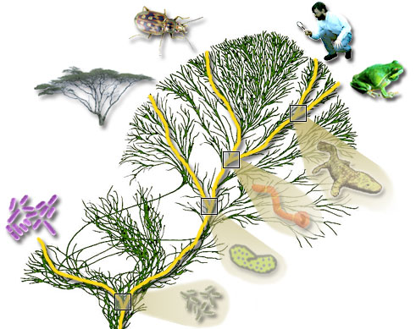
Modern Transcriptome Studies Empowered by RNA-seq
Extract RNA, convert to cDNA
Next-gen Sequencer
(pick your favorite)
Millions to Billions of Reads
Notes:
Modern transcriptome studies are termed RNA-Seq

Slide 5
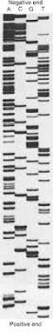
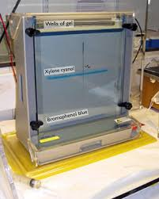
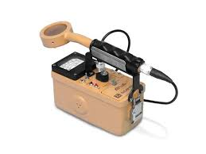
Personal Reflections...
Circa 1995

Slide 6
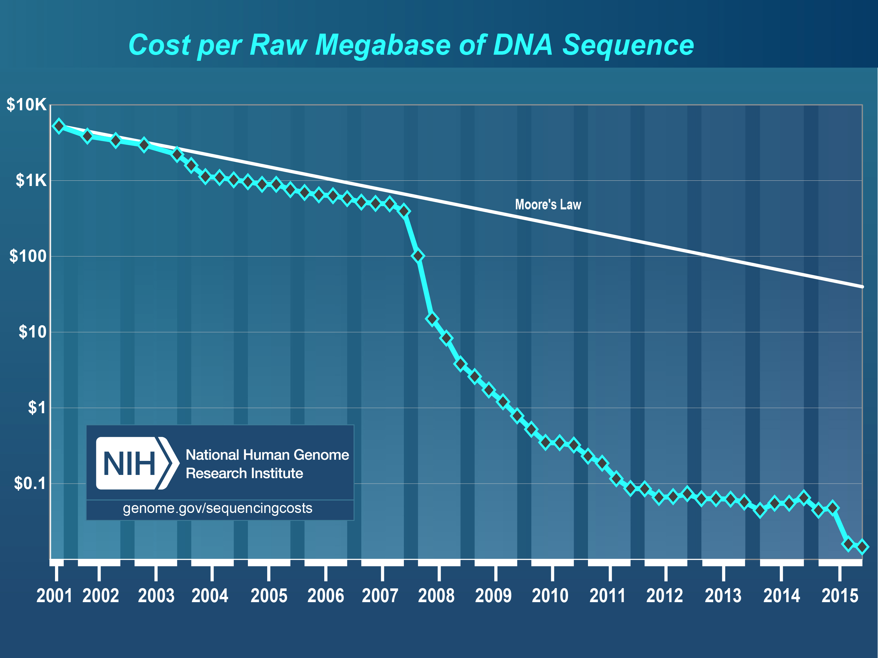
Hello Next-Gen Sequencing!
From https://www.genome.gov/sequencingcostsdata/
Notes:
We’ve witnessed a technological revolution.
Routinely sequencing as an assay for biological discovery.

Slide 7
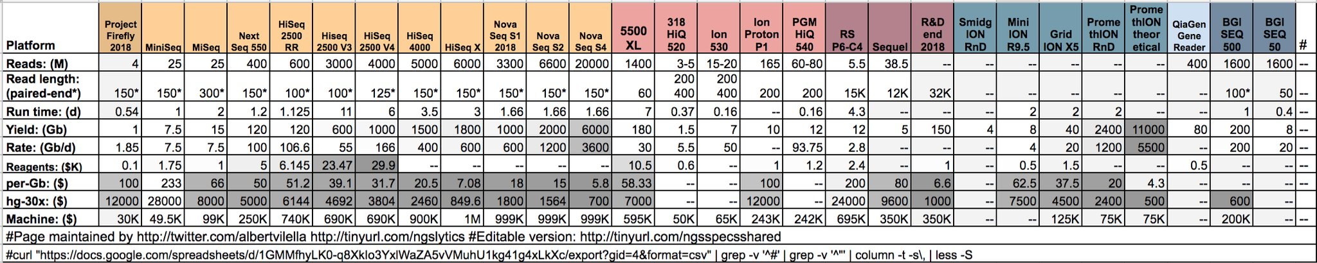
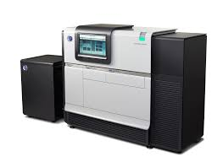
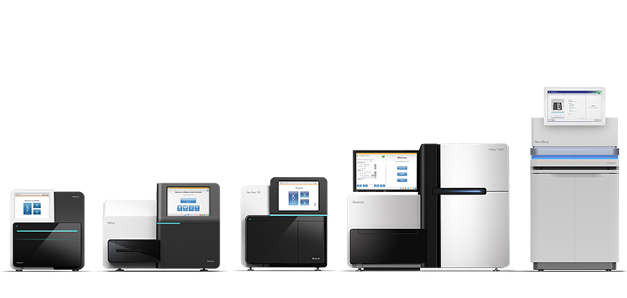
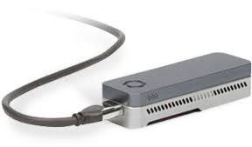
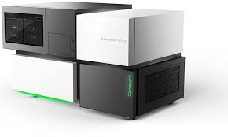
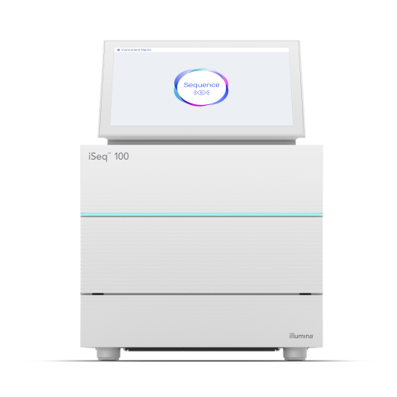
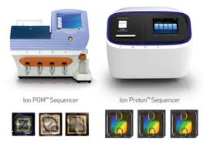
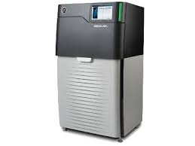
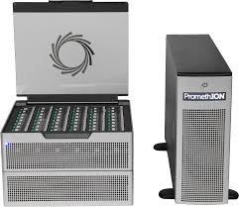
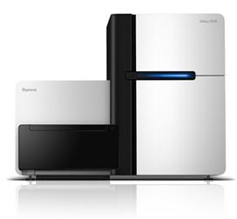
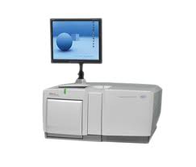
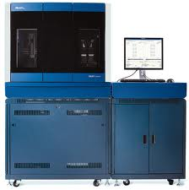
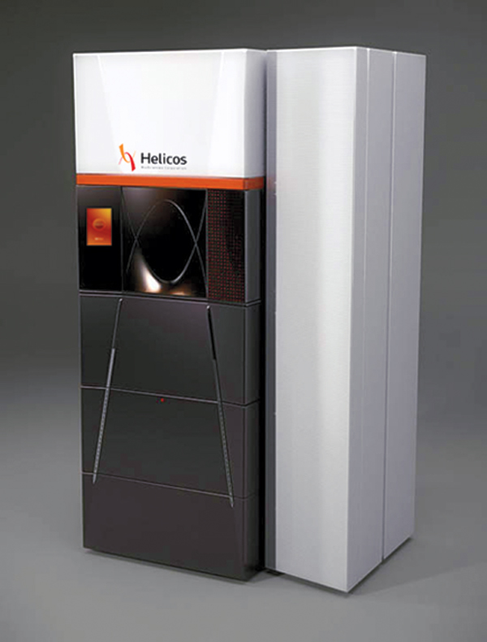
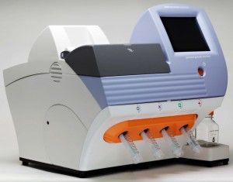
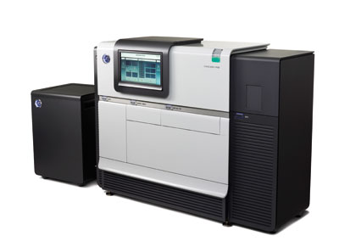
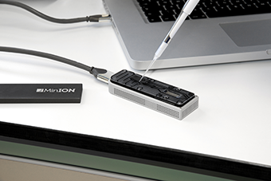
Generating RNA-Seq: How to Choose?
iSeq
Stats circa 2018
For current, see: https://tinyurl.com/wbgcs65
*Not all shown at scale
Illumina
454
SOLiD
Helicos
Ion Torrent
Pacific Biosciences
Oxford Nanopore
Slide courtesy of Joshua Levin, Broad Institute.
Notes:
The current technological landscape for sequences is somewhat diverse, although there are some clear favorites and those that are currently dominating the market.
Illumina, in particular, is one of the dominating technologies.
This here is a table that contrasts the features of the different sequencers including cost, throughput, runtimes, read lengths, etc.
Prices vary considerably according to these specs, anywhere from tens of thousands to a million dollars, and that doesn’t cover the reagent costs. Julian covered many of these last week.

Slide 8
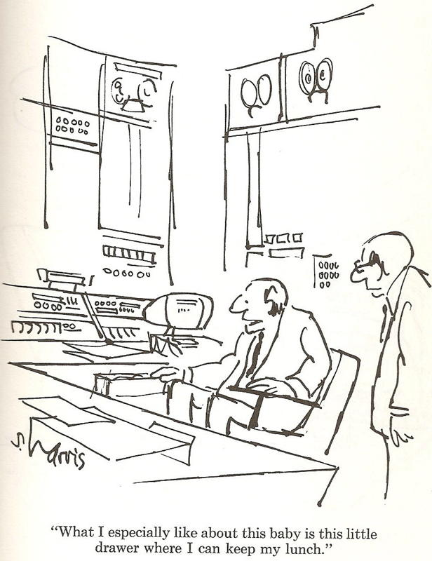
Generating RNA-Seq: How to Choose?
*Not all shown at scale
Thx Joshua Levin, for the cartoon. ☺
Illumina
454
SOLiD
Helicos
Ion Torrent
Pacific Biosciences
Oxford Nanopore
Slide courtesy of Joshua Levin, Broad Institute.
Notes:
Everyone has different reasons for choosing one.

Slide 9
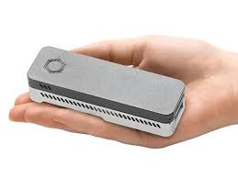
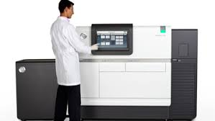
Each has pros/cons

Slide 10
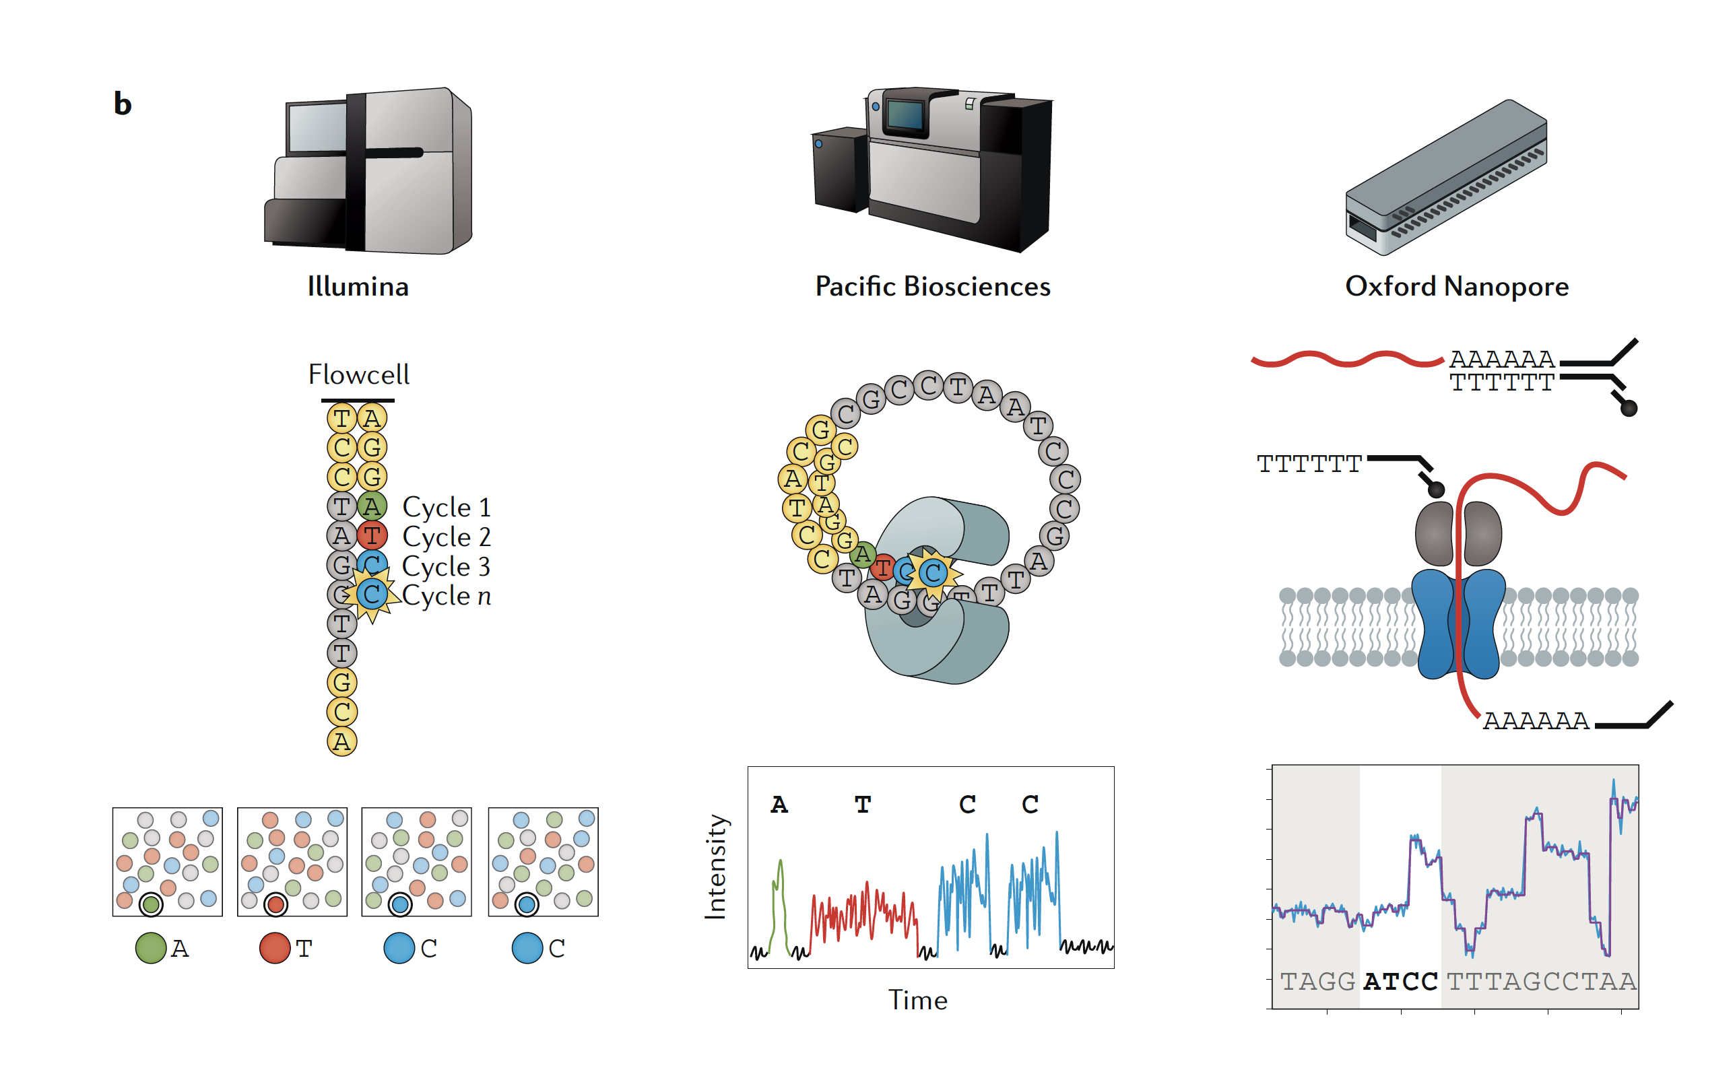
Today’s Most Popular Sequencing Technologies
Images from “RNA sequencing: the teenage years”
Rory Stark, Marta Grzelak & James Hadfield
Nature Reviews Genetics volume 20, pages631–656(2019)

Slide 11
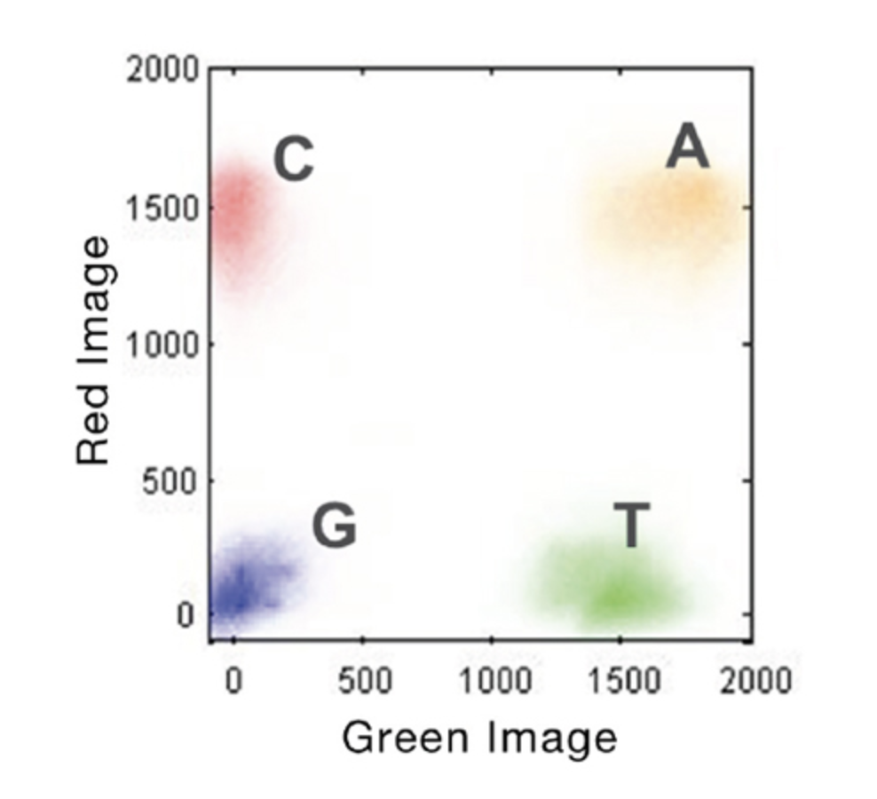
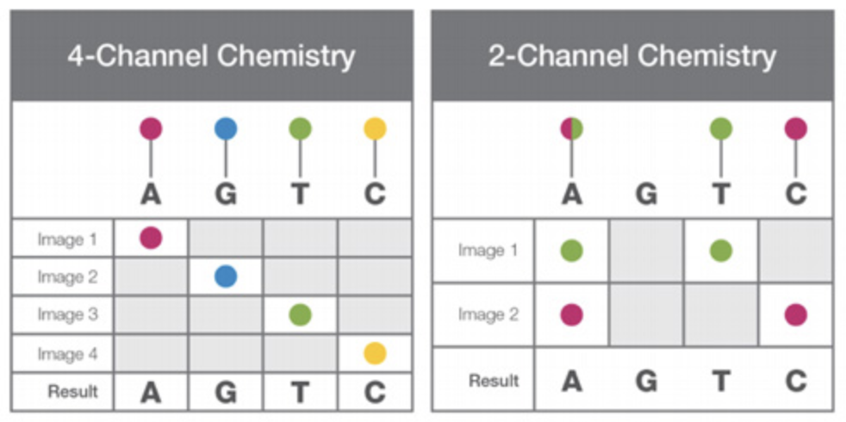
Today’s Most Popular Sequencing Technologies
Hundreds of millions to billions of highly accurate but shorter reads. ($)
Limited sequencing depth, but highly accurate full-length single molecule reads. ($$$)
Limited sequencing depth, and moderate-to-highly accurate full-length single molecule reads. ($$)
Images from “RNA sequencing: the teenage years”
Rory Stark, Marta Grzelak & James Hadfield
Nature Reviews Genetics volume 20, pages631–656(2019)
Video at: https://youtu.be/fCd6B5HRaZ8
Notes:
Illumina uses a ‘sequence by synthesis’ technique where fragmented sequences are separated onto a slide, and flurorophore labeled bases are flowed in cycles, one flow cycle for each nucleotide. Each of the bases has a different colored fluorophre. A laser is used to excite the fluorophore, and newly incorporated bases light up as colored spots on the slide. Image processing is used to read off the sequences that are being synthesized at each spot on the slide, one nucleotide at a time.
The original technology leveraged 4 fluorophores and 4 image analyses per cycle, with each base having a different color. Newer machines leverage a 2 color technology.

Slide 12
Today’s Most Popular Sequencing Technologies
Hundreds of millions to billions of highly accurate but shorter reads. ($)
Limited sequencing depth, but highly accurate full-length single molecule reads. ($$$)
Limited sequencing depth, and moderate-to-highly accurate full-length single molecule reads. ($$)
Images from “RNA sequencing: the teenage years”
Rory Stark, Marta Grzelak & James Hadfield
Nature Reviews Genetics volume 20, pages631–656(2019)
Video at: https://www.youtube.com/watch?v=WMZmG00uhwU
Notes:
Pac bio: Signal durations per base
Zero mode wave guide with a DNA polymerase bound at the bottom of a channel.
dNTPs are available for synthesis, each one labeled a different color, and movies are taken that watch as different bases get inserted. The different bases are not only colored differently, but also take different amounts of time to get incorporated, and from these signals, the sequence can be deciphered.

Slide 13
Today’s Most Popular Sequencing Technologies
Video: https://nanoporetech.com/how-it-works#fullVideo&modal=fullVideo
Hundreds of millions to billions of highly accurate but shorter reads. ($)
Limited sequencing depth, but highly accurate full-length single molecule reads. ($$$)
Limited sequencing depth, and moderate-to-highly accurate full-length single molecule reads. ($$)
Images from “RNA sequencing: the teenage years”
Rory Stark, Marta Grzelak & James Hadfield
Nature Reviews Genetics volume 20, pages631–656(2019)
Can do direct RNA sequencing! and find evidence for methylation
Notes:
Nanopore: 3 central nucleotides determine the signal, but adjacent bases contribute.
Disruption of current measured in signal trace.
No synthesis, but rather a motor protein pushes the sequence through a nanopore.
See paper: https://www.nature.com/articles/s41587-021-01108-x

Slide 14
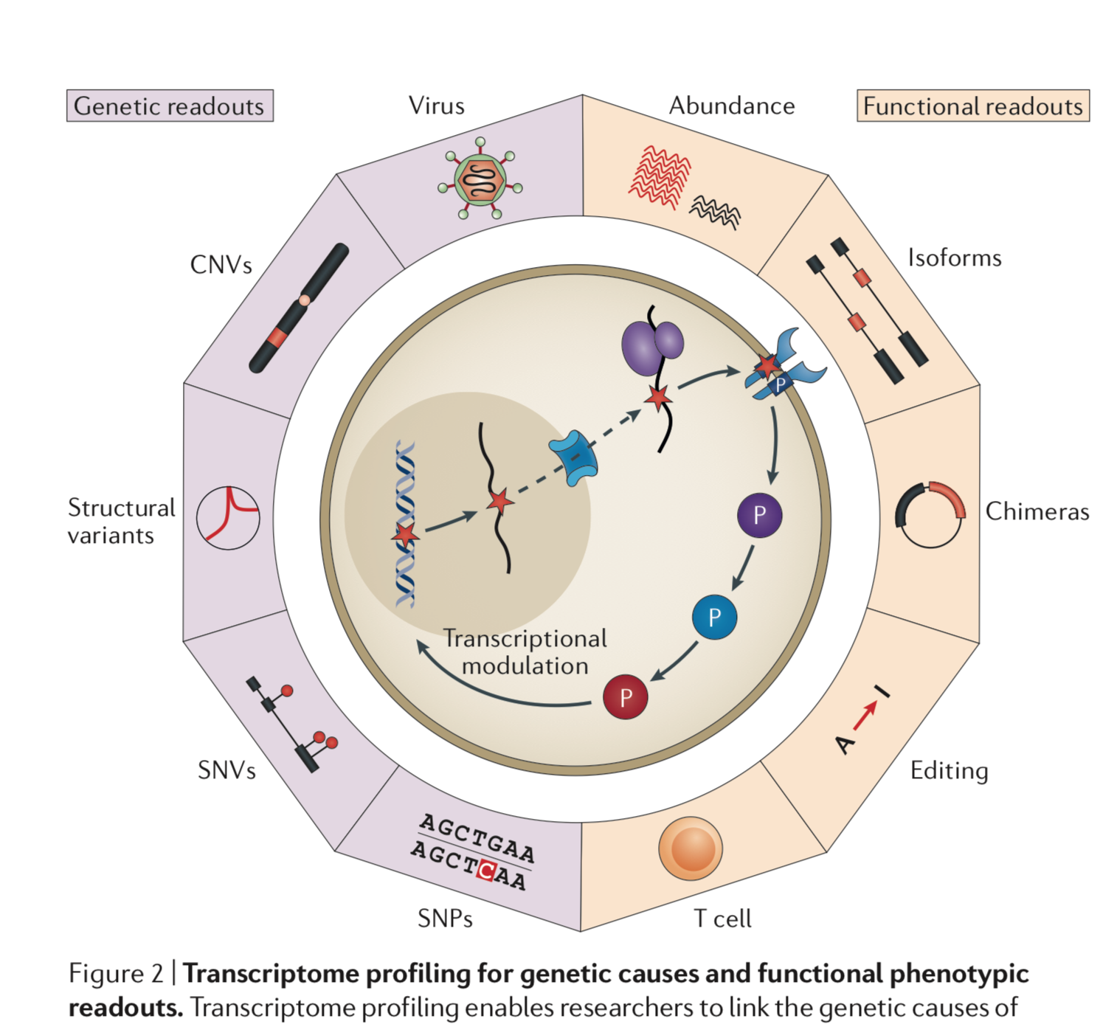
A Plethora of Biological Sequence Analyses Enabled by RNA-Seq
(ie. mutations)
From Cieslik and Chinnaiyan, NRG, 2017

Slide 15
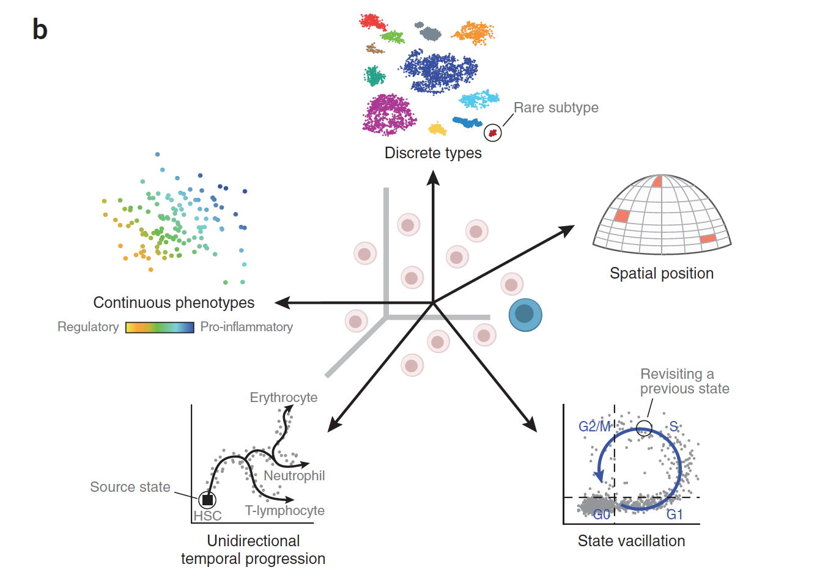
RNA-Seq is Empowering Discovery at Single Cell Resolution
Wagner, Regev, and Yosef. NBT 2016
Notes:
Primary – cell type analysis
Spatial transcriptomics
State vacillation such as cell cycling
Differentiation trajectories
And evaluating continuous phenotypes

Slide 16
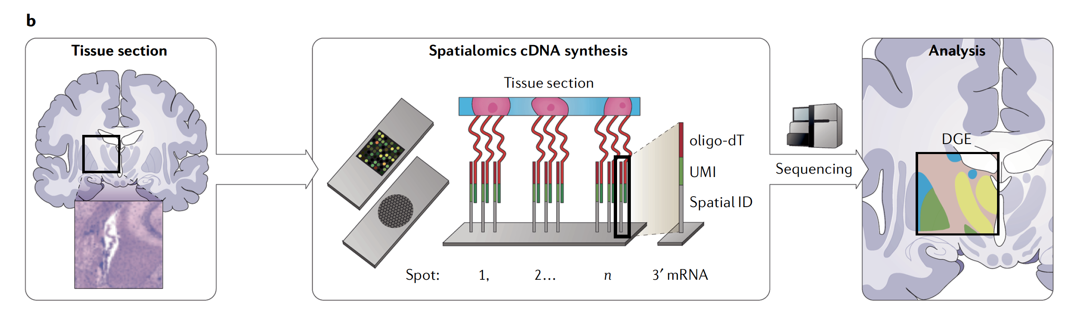
Spatial Transcriptomics
Spatial Encoding
From “RNA sequencing: the teenage years”
Rory Stark, Marta Grzelak & James Hadfield
Nature Reviews Genetics volume 20, pages631–656(2019)
Notes:
Major advances in spatial transcriptomics to explore transcriptomics at the single cell level in a spatial context, and in some cases getting to subcellular resolution.
Spatial encoding – tissue slice, affix to slide having barcoded oligos with assigned positions on the slide, do library prep on the slide, remove the amplified cDNAs containing the positional barcode info, sequence it, and then use the barcoding to in silico reconstruct the original image based on transcript expression data.

Slide 17

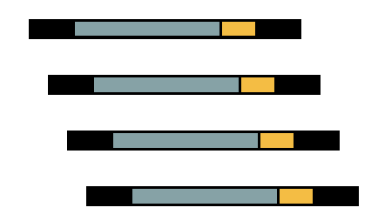
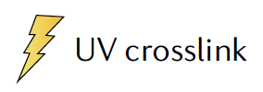
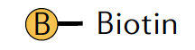
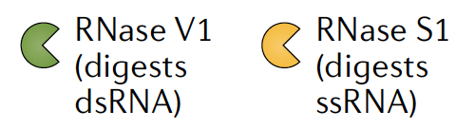
A Myriad of Other Specialized
RNA-seq -based Applications
RNA-Sequencing as your lens towards biological discovery
Adapted from “RNA sequencing: the teenage years”
Rory Stark, Marta Grzelak & James Hadfield
Nature Reviews Genetics volume 20, pages631–656(2019)
Notes:
RNA-seq to enable other biological insights / discoveries – just make RNA-sequencing your experimental assay. Capture the sequences of interest or the parts of the transcripts that matter and sequence them.

Slide 18
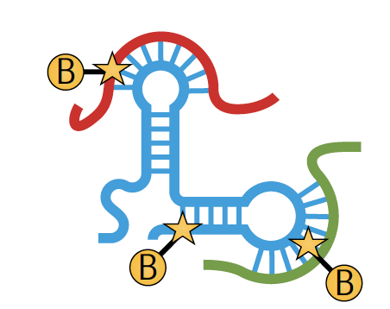
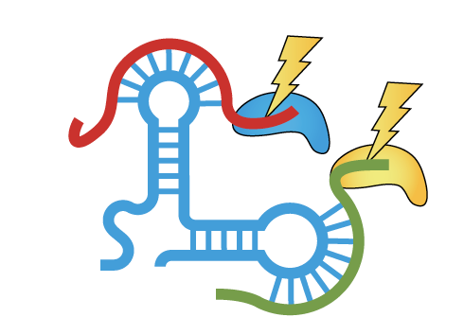
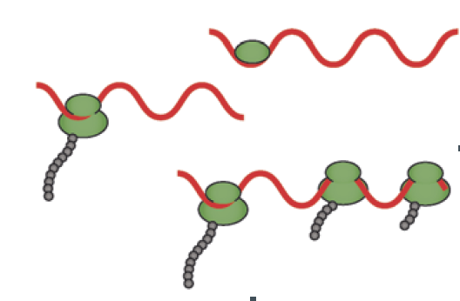
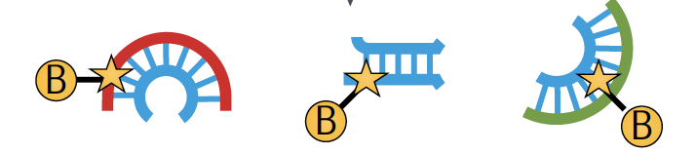





A Myriad of Other Specialized
RNA-seq -based Applications
RNA-RNA interactions
RNA-Protein Interactions
Ribosomal profiling
RNA Structuromics
Adapted from “RNA sequencing: the teenage years”
Rory Stark, Marta Grzelak & James Hadfield
Nature Reviews Genetics volume 20, pages631–656(2019)
Notes:
RNA-seq to enable other biological insights / discoveries – just make RNA-sequencing your experimental assay

Slide 19

Notes:
Number of papers as a reflection of the growth of popularity in RNA-seq as a discovery tool.

Slide 20
Transcriptomics Lecture Overview
Overview of RNA-Seq
Transcript reconstruction methods
Trinity de novo assembly
Transcriptome quality assessment (coffee break)
Expression quantification
Differential expression analysis
Functional annotation
Case study: salamander transcriptome

Slide 21
Part 1. Overview of RNA-Seq

Slide 22


RNA-seq library fragmentation and size selection strategies that influence interpretation and analysis.
Griffith et al., 2015
http://journals.plos.org/ploscompbiol/article?id=10.1371/journal.pcbi.1004393
Notes:
RNA-seq begins with first isolating RNA from your organism, tissue, or sample of interest.

Slide 23
RNA-seq library fragmentation and size selection strategies that influence interpretation and analysis.
Griffith et al., 2015
http://journals.plos.org/ploscompbiol/article?id=10.1371/journal.pcbi.1004393
Notes:
You might quality check your RNA by running an aliquot on an agarose gel.
If you run fully intact total RNA on a gel, you’ll likely just see two dominant bands. Guess what these might be.
If your total RNA is partially or heavily degraded, you might see a smear or a high density of smaller fragments.
If you run intact mRNA, you should see a smear of large to small fragments, and importantly, a lack of the striking bands seen in total RNA.

Slide 24

RNA-seq library fragmentation and size selection strategies that influence interpretation and analysis.
Griffith et al., 2015
http://journals.plos.org/ploscompbiol/article?id=10.1371/journal.pcbi.1004393
Notes:
Bioanalyzer, RIN numbers – rna integrity number
More sophisticated and precise methods are available instead such as running a sample on a bioanalyzer device, which uses a capillary electrophoresis system to generate a profile of molecule size densities and providing an overall classification of RNA quality using what they define as a RIN score (RNA integrity).

Slide 25
RNA-seq library fragmentation and size selection strategies that influence interpretation and analysis.
Griffith et al., 2015
http://journals.plos.org/ploscompbiol/article?id=10.1371/journal.pcbi.1004393
Notes:
If you’re planning to go ahead and sequence the RNA via Illumina, there’s some laboratory processing required such as removing any contaminating DNA with DNAse, and enriching for the types of RNA molecules that you want to sequence.

Slide 26
RNA-seq library fragmentation and size selection strategies that influence interpretation and analysis.
Griffith et al., 2015
http://journals.plos.org/ploscompbiol/article?id=10.1371/journal.pcbi.1004393
Notes:
RNAs are then fragmented and reverse transcribed to cDNA.

Slide 27
RNA-seq library fragmentation and size selection strategies that influence interpretation and analysis.
Griffith et al., 2015
http://journals.plos.org/ploscompbiol/article?id=10.1371/journal.pcbi.1004393
Notes:
Size selection is then performed to capture the fragment lengths that are optimal for illumine sequencing, generally in the range of 300 to 500 bases. One way to do it would be to cut out a region from an agarose gel in that size range, but there are simpler ways involving columns with beads. Note, in this size selection, the small RNAs are lost, and so you’d need other specialized methods if you’re wanting to sequence small or microRNAs.

Slide 28
RNA-seq library fragmentation and size selection strategies that influence interpretation and analysis.
Griffith et al., 2015
http://journals.plos.org/ploscompbiol/article?id=10.1371/journal.pcbi.1004393
Notes:
Finally, add your sequencing adaptors, and then go on to sequencing.

Slide 29

RNA-seq library enrichment strategies that influence interpretation and analysis.
Griffith et al., 2015
http://journals.plos.org/ploscompbiol/article?id=10.1371/journal.pcbi.1004393
Notes:
When you initially isolate your RNA in the first step, you’re going to have a diverse collection of RNA molecules, including coding and non-coding RNAs.
Most of the RNA molecules are going to be ribosomal RNA (>90%).

Slide 30
RNA-seq library enrichment strategies that influence interpretation and analysis.
Griffith et al., 2015
http://journals.plos.org/ploscompbiol/article?id=10.1371/journal.pcbi.1004393
Notes:
If you decide to just sequence everything, nearly all your reads are going to correspond to rRNA, and so overall information content of your sequencing data is going to be very low – and spending lots of $$ on just sequencing the same molecule over and over.

Slide 31
RNA-seq library enrichment strategies that influence interpretation and analysis.
Griffith et al., 2015
http://journals.plos.org/ploscompbiol/article?id=10.1371/journal.pcbi.1004393
Notes:
If you really want to sequence total RNA but avoid just sequencing rRNA over and over again, there are various depletion strategies available, including commercially available kits (ie. ribozero).
These strategies can be highly effective but note there are caveats with sequencing total RNA – in addition to capturing coding transcripts, you’ll sequence a lot of noncoding RNA and partially spliced or unprocessed immature RNA molecules.

Slide 32
RNA-seq library enrichment strategies that influence interpretation and analysis.
Griffith et al., 2015
http://journals.plos.org/ploscompbiol/article?id=10.1371/journal.pcbi.1004393
Notes:
If you know ahead of time what transcripts you want to survey, you could design a capture array and just retain those transcripts of interest. This would be a lot like current exome sequencing strategies.
Often, though, you’ll likely be more interested in doing a less biased and more comprehensive survey, particularly if you’re not working with a well studied model organism.

Slide 33
RNA-seq library enrichment strategies that influence interpretation and analysis.
Griffith et al., 2015
http://journals.plos.org/ploscompbiol/article?id=10.1371/journal.pcbi.1004393
Notes:
The most popular method is to focus on sequencing coding RNAs or messenger RNAs, which differ from most other RNA molecules in that they have a poly-A tail. This polyA-tail can be captured to pull out and sequence only those RNAs of interest.
The caveat here is that you must have high quality RNA for this to work well. If the RNA is heavily degraded, then you’ll only be capturing the very 3’ end of each degraded transcript, and so one of the other alternative strategies would be more appropriate in those circumstances.

Slide 34
Part 2. Transcript Reconstruction Methods

Slide 35

RNA-Seq Challenge: Transcript Reconstruction
(Avg. ~ 2 kb)
(Avg. ~ 300 b)
Reconstruct original full-length transcripts
(~ 75 to 150 b reads, SE or PE)
Adapted from: http://www2.fml.tuebingen.mpg.de/raetsch/members/research/transcriptomics.html
Notes:
In any case, the transcriptome reads that are generated from sequencing are often much shorter than the original transcript molecules they were derived from, and one of the key bioinformatic challenges is to reconstruct the original full length transcript from the shorter sequencing reads.

Slide 36


Transcript Reconstruction from RNA-Seq Reads
Nature Biotech, 2010
Notes:
One of the primary goals in RNA-Seq studies is to reconstruct the transcripts from which the short reads were derived, and transcript reconstruction is often a prerequisite to downstream studies such as genome annotation or diifferential expression analysis.
Two general strategies have been explored for reconstructing transcripts from RNA-Seq reads.

Slide 37
Transcript Reconstruction from RNA-Seq Reads
Notes:
One strategy requires having a reference genome and involves first aligning reads to the genome using a spliced aligner.

Slide 38
Transcript Reconstruction from RNA-Seq Reads
Notes:
Then, the alignments, instead of the original reads, are assembled into transcript structures.

Slide 39



Transcript Reconstruction from RNA-Seq Reads
Trinity
TopHat
The Tuxedo Suite:
End-to-end Genome-based RNA-Seq Analysis Software Package
Cufflinks
GMAP
Notes:
Then, if a genome sequence is available, the assembled transcripts can be aligned to the genome to reveal individual introns and exons.

Slide 40

Transcript Reconstruction from RNA-Seq Reads
Trinity
HISAT
The “New Tuxedo” Suite:
End-to-end Genome-based RNA-Seq Analysis Software Package
String Tie
GMAP
Notes:
Then, if a genome sequence is available, the assembled transcripts can be aligned to the genome to reveal individual introns and exons.

Slide 41
Transcript Reconstruction from RNA-Seq Reads
Trinity
HISAT
The “New Tuxedo” Suite:
End-to-end Genome-based RNA-Seq Analysis Software Package
Non-model organisms:
“I don’t have a reference genome!”
String Tie
GMAP
Notes:
Then, if a genome sequence is available, the assembled transcripts can be aligned to the genome to reveal individual introns and exons.

Slide 42
Transcript Reconstruction from RNA-Seq Reads
TopHat
Cufflinks
Notes:
An alternative strategy doesn’t require a reference genome and involves assembling the read sequences directly.

Slide 43
Transcript Reconstruction from RNA-Seq Reads
TopHat
Cufflinks
Notes:
Then, if a genome sequence is available, the assembled transcripts can be aligned to the genome to reveal individual introns and exons.

Slide 44


Transcript Reconstruction from RNA-Seq Reads
End-to-end Transcriptome-based RNA-Seq Analysis Software Package
Trinity
GMAP
Notes:
Trinity is a software tool that I helped develop, and which we published last year in Nature Biotechnology.
In this talk, I’ll describe how Trinity works, and describe some of the applications that we aim to support.

Slide 45
Transcript Reconstruction from RNA-Seq Reads
Many tools to choose among:
Trinity
Oases
SoapDenovoTrans
AbyssTrans
IDBA-Tran
Shannon
BinPacker
Bridger
…
TopHat STAR HISAT2
GSNAP
…
GMAP
BLAT
AAT
Spidey
Sim4
…
Cufflinks
Stringtie
IsoLasso
Bayesembler
Trip
Traph
CEM
TransComb
Scallop
…
Notes:
Since the advent of RNA-Seq about a decade ago, there has been great progress in the development of bioinformatics tools for performing all of these operations, supporting both genome-guided and genome-free transcriptome reconstruction and analysis.
In the next series of slides, I’ll describe the basic computational algorithms used for transcript reconstruction.

Slide 46
Transcript Reconstruction from RNA-Seq Reads
Many tools to choose among:
Trinity
Oases
SoapDenovoTrans
AbyssTrans
IDBA-Tran
Shannon
BinPacker
Bridger
…
TopHat STAR HISAT2
GSNAP
…
How does it work?
GMAP
BLAT
AAT
Spidey
Sim4
…
Cufflinks
Stringtie
IsoLasso
Bayesembler
Trip
Traph
CEM
TransComb
Scallop
…
Notes:
Since the advent of RNA-Seq about a decade ago, there has been great progress in the development of bioinformatics tools for performing all of these operations, supporting both genome-guided and genome-free transcriptome reconstruction and analysis.
In the next series of slides, I’ll describe the basic computational algorithms used for transcript reconstruction.

Slide 47
Graph Data Structures Commonly Used For Assembly
Sequence
Order
Orientation (+, -)
Overlap
Reads to Graph
GTC
AGTCA
GATC
CG
GATTACA
CGATCA
AGC
Nodes = sequence (+/-)
Edges = order, overlap
Notes:
Both the genome-guided and genome-free transcript reconstruction approaches share some common algorithmic techniques.
----
A general features of these algorithms is to encode read sequences, read order, orientation, and overlap information
---
into a directed graph structure, with oriented sequences represented by nodes, and directed edges indicating overlap and orientation.

Slide 48
Graph Data Structures Commonly Used For Assembly
Sequence
Order
Orientation (+, -)
Overlap
Reads to Graph
GTC
AGTCA
GATC
CG
GATTACA
CGATCA
AGC
GATCGTCCGAGCGATTACA
Nodes = sequence (+/-)
Edges = order, overlap
Notes:
Full length transcripts are then reconstructed by traversing a directed path in the graph, guided by characteristics of the original reads including mate-pair constraints.
If there are multiple well-supported paths through this graph, then this would be considered evidence for alternative splicing.

Slide 49

Genome-Guided Transcript Reconstruction
Splice-align reads to the genome
From Martin & Wang. Nature Reviews in Genetics. 2011
Notes:
In the case of genome-guided transcript reconstruction, the reads are aligned to the genome instead of being aligning to each other, and so we don’t encounter this scalability problem.
Here, the genome provides a scaffold by which the reads are ordered, oriented, and their overlaps are readily defined according to genomic location.
Here’s an example of a region of the genome where RNA-Seq reads were aligned…

Slide 50
Genome-Guided Transcript Reconstruction
Splice-align reads to the genome
Alignment segment piles => exon regions
From Martin & Wang. Nature Reviews in Genetics. 2011
Notes:
and we see stacks of reads piling up at locations throughout this locus.
The piles of alignment segments provide evidence of exons

Slide 51
Genome-Guided Transcript Reconstruction
Splice-align reads to the genome
Large alignment gaps => introns
From Martin & Wang. Nature Reviews in Genetics. 2011
Notes:
And the large gaps between alignment segments provide evidence of introns that were spliced out in the mature transcript.

Slide 52
Genome-Guided Transcript Reconstruction
Splice-align reads to the genome
Overlapping but different introns = evidence of alternative splicing
From Martin & Wang. Nature Reviews in Genetics. 2011
Notes:
In some cases, candidate introns are found to overlap but have different end points, and this provides evidence of alternative splicing.

Slide 53
Genome-Guided Transcript Reconstruction
Splice-align reads to the genome
From Martin & Wang. Nature Reviews in Genetics. 2011
Notes:
As discussed earlier, in order to assemble transcripts we’re going to encode the RNA-Seq data into a directed graph.
Based on the RNA-Seq read alignments, we were able to identify the individual exon and intron components of the gene expressed at this locus.

Slide 54
Genome-Guided Transcript Reconstruction
Splice-align reads to the genome
Individual reads can yield multiple exon and intron segments (splice patterns)
From Martin & Wang. Nature Reviews in Genetics. 2011
Notes:
If we look carefully, we can find examples of individual reads aligning to the genome and providing evidence for multiple introns and exons, and so we know that those introns and exons should be connected in the final transcript reconstructions.

Slide 55

Genome-Guided Transcript Reconstruction
Splice-align reads to the genome
Nodes = unique splice patterns
From Martin & Wang. Nature Reviews in Genetics. 2011
Notes:
We can identify all such unique splice patterns provided by the reads, and start building our graph using the splice patterns as nodes.

Slide 56

Genome-Guided Transcript Reconstruction
Splice-align reads to the genome
Construct graph from unique splice patterns of aligned reads.
Nodes = unique splice patterns
From Martin & Wang. Nature Reviews in Genetics. 2011
Notes:
We do this for all unique splice patterns. Here, the number of splice patterns is just a small fraction of the total number of aligned reads, and so we have a relatively few number of nodes to work with in our graph.

Slide 57
Genome-Guided Transcript Reconstruction
Splice-align reads to the genome
Construct graph from unique splice patterns of aligned reads.
Nodes = unique splice patterns
Edges = compatible patterns
From Martin & Wang. Nature Reviews in Genetics. 2011
Notes:
We then incorporate edges into the graph, drawing an edge between splice patterns that overlap and are compatible, that is to say that they could have come from the same transcript isoform. These are all cases where the splice patterns overlap and if there are introns in the overlapping region, those introns have identical splice sites.
For example, these top two alignment patterns overlap and they don’t conflict in their region of overlap. They could have come from the same transcript isoform, and so we can draw an edge between them.
----
Similarly, this splicing pattern demonstrates overlap, and the overlapping introns have identical splice sites, so these are deemed compatible, possibly deriving from the same transcript isoform, and we draw an edge between them.
----
We do this for all overlapping splice patterns.

Slide 58
Genome-Guided Transcript Reconstruction
Splice-align reads to the genome
Construct graph from unique splice patterns of aligned reads.
Nodes = unique splice patterns
Edges = compatible patterns
From Martin & Wang. Nature Reviews in Genetics. 2011
Notes:
Here we have those splice patterns that overlap but have different introns, and these could not have come from the same transcript, so we cannot draw an edge between them in our graph.

Slide 59

Genome-Guided Transcript Reconstruction
Traverse paths through the graph to assemble transcript isoforms
From Martin & Wang. Nature Reviews in Genetics. 2011
Notes:
Once we’ve completed our graph, we can then traverse paths through the graph to reconstruct candidate isoforms.
Here, we’ve outlined 4 possible paths…

Slide 60

Genome-Guided Transcript Reconstruction
Traverse paths through the graph to assemble transcript isoforms
Reconstructed isoforms
From Martin & Wang. Nature Reviews in Genetics. 2011
Notes:
And tracing each path yields a different transcript structure.
There are a large number of variations of this technique, and it usually involves scoring the possible paths according to some objective function, and only reporting those candidate isoform reconstructions that are best supported by the read alignments.

Slide 61
What if you don’t have a high quality reference genome sequence?
Genome-free de novo transcript reconstruction to the rescue.

Slide 62
Read Overlap Graph: Reads as nodes, overlaps as edges
Notes:
One way to build such a graph is treat each read as a separate node, and to perform all combinations of pairwise alignments between reads in order to identify overlaps and extensions.

Slide 63
Read Overlap Graph: Reads as nodes, overlaps as edges
Node = read
Edge = overlap
Notes:
From the overlap information, we would build an overlap graph with reads as nodes and overlaps as edges.

Slide 64
Read Overlap Graph: Reads as nodes, overlaps as edges
Transcript A
Generate consensus sequence where reads overlap
Node = read
Edge = overlap
Transcript B
Notes:
One could then trace the path of overlap extensions to assemble the longer sequence
----
If there are minor sequence differences in the regions of overlap that are likely due to sequencing error, these could be corrected by just taking a consensus and taking any original read quality information into account.

Slide 65

Finding pairwise overlaps between n reads involves ~ n² comparisons.
Impractical for typical RNA-Seq data (50M reads)
Notes:
This approach can be highly effective, but it simply doesn’t scale well for large data sets such as those generated using RNA-Seq.
Building the overlap graph involved aligning and comparing each read to every other read. If we have ‘n’ reads, then this would involve roughly n^2 number of comparisons.
----
If we plot the number of pairwise alignments required as a function of the number of reads, we see that the number of alignments grows exponentially.
----
This is a problem because it means that the amount of time it would take to do the alignments as well as the amount of computer hardware required to store the information would also grow exponentially, and so it’s just not a viable approach for assembling the many millions or billions of reads generated in an RNA-Seq experiment.

Slide 66
No genome to align to… De novo assembly required
Want to avoid n² read alignments to define overlaps
Use a de Bruijn graph
Have you learned about the de Bruijn graph already?
Notes:
If we don’t have a genome to align to, we need to be able to assemble the reads directly, but we need a way to avoid doing all pairwise alignments between the reads.
----
A popular technique for doing de novo assembly of short reads is to leverage a de Bruijn graph data structure. The de Bruijn graph was initially applied to genome assembly and was later adopted for transcriptome assembly. There are some key differences between assembling genomes and assembling transcriptomes using de Bruijn graphs, and I’ll comment more on that shortly.

Slide 67

Sequence Assembly via de Bruijn Graphs
Generate all substrings of length k from the reads
k-mers (k=5)
Reads
From Martin & Wang, Nat. Rev. Genet. 2011
Notes:
A de Bruijn graph represents connectivity between sequences observed within reads, and the overlaps between reads are apparent by the virtue of having shared substrings.
The first step in a de Bruijn graph-based assembly is to construct the de Bruijn graph from the sequence reads.
Each read is decomposed into substrings of some specified length k. Each word of length k is called a k-mer. In this example, k is set to 5, so here each 5-mer is extracted from the read.
----
An ordered list of k-mers is generated by scanning a window of length k across the length of the read.

Slide 68
Sequence Assembly via De Bruijn Graphs
Generate all substrings of length k from the reads
k-mers (k=5)
Reads
From Martin & Wang, Nat. Rev. Genet. 2011
Notes:
That kmer is extracted from the read sequence

Slide 69

Sequence Assembly via De Bruijn Graphs
Generate all substrings of length k from the reads
k-mers (k=5)
Reads
Construct the de Bruijn graph
Nodes = unique k-mers
From Martin & Wang, Nat. Rev. Genet. 2011
Notes:
and inserted as a node in our de Bruijn graph. This graph node now represents this unique kmer sequence, and this single node will represent this unique kmer for every occurrence of this kmer in the entire set of reads.

Slide 70
Sequence Assembly via De Bruijn Graphs
Generate all substrings of length k from the reads
k-mers (k=5)
Reads
Construct the de Bruijn graph
Nodes = unique k-mers
Edges = overlap by (k-1)
From Martin & Wang, Nat. Rev. Genet. 2011
Notes:
We then shift the window over by one base, extract that k-mer…

Slide 71
Sequence Assembly via De Bruijn Graphs
Generate all substrings of length k from the reads
k-mers (k=5)
(k-1) overlap
Reads
Construct the de Bruijn graph
Nodes = unique k-mers
Edges = overlap by (k-1)
From Martin & Wang, Nat. Rev. Genet. 2011
Notes:
and insert it as another node in our de Bruijn graph.

Slide 72
Sequence Assembly via De Bruijn Graphs
Generate all substrings of length k from the reads
k-mers (k=5)
(k-1) overlap
Reads
Construct the de Bruijn graph
Nodes = unique k-mers
Edges = overlap by (k-1)
From Martin & Wang, Nat. Rev. Genet. 2011
Notes:
For each pair of neighboring k-mers, which overlap by k-1 bases, we include an edge between them in the graph.

Slide 73
Sequence Assembly via De Bruijn Graphs
Generate all substrings of length k from the reads
k-mers (k=5)
Reads
Construct the de Bruijn graph
Nodes = unique k-mers
Edges = overlap by (k-1)
From Martin & Wang, Nat. Rev. Genet. 2011
Notes:
We continue to do this for all reads and fully construct our de Bruijn graph.
This de Bruijn graph is a very effective and compact way of representing the sequence data within the reads. For example, hundreds of millions of reads can be sequenced, and the identical sequence regions within reads become compressed into individual nodes within the graph.
At positions where related sequences diverge due to allelic polymorphisms, splicing variations, repeats, or due to sequencing errors, the graph will branch and can form bulges or loops.

Slide 74

Construct the de Bruijn graph
Collapse the de Bruijn graph
From Martin & Wang, Nat. Rev. Genet. 2011
Notes:
After building the graph from all the reads, the graph is typically pruned to remove bubbles and structures that likely stem from sequencing errors,
and the graph is further simplified by collapsing those nodes that form linear unbranched chains of overlapping k-mers.
--
For example, this linear chain of kmers is compressed into a single node in the compacted graph.

Slide 75


Collapse the de Bruijn graph
Traverse the graph
Assemble Transcript Isoforms
From Martin & Wang, Nat. Rev. Genet. 2011
Notes:
Now, to reconstruct transcripts, we define paths in the graph that are supported by the reads, and traverse those paths to reconstruct complete isoform sequences.
--
In this example, there are again four possible paths from the beginning to the end of the graph, each path shown traced by a different color.
By traversing each path, a different transcript sequence is generated.
--
Again, there are many different algorithms and techniques for defining best paths within this graph, and ideally the best paths reported are those that are best supported by the RNA-Seq data, taking into account the paths supported by individual read sequences and any mate-pairing information that may be available.

Slide 76
Part 3. Trinity De novo Assembly

Slide 77

Contrasting Genome and Transcriptome Assembly
Genome Assembly
Transcriptome Assembly
Uniform coverage
Single contig per locus
Double-stranded
Exponentially distributed coverage levels
Multiple contigs per locus (alt splicing)
Strand-specific
Notes:
Both genome and transcriptome assemblers leverage the de Bruijn graph structure, but are tuned to assemble reads according to very different expected characteristics. This is why you wouldn’t want to leverage a genome assembler for transcriptome assembly and vice-versa, since each method is highly specialized.
Some of the key differences between genome and transcriptome assemblers include the following:
--
Genome assemblers expect that read coverage is going to be rather uniform and will often discard sequences that occur at high coverage as repetitive sequences. Transcriptome assembly needs to consider a wide range of coverage levels spanning several orders of magnitude since sequences with high coverage are more likely to represent highly expressed transcripts instead of repeats.
--
Genome assemblers aim to generate a single contig per locus, possibly two if tuned to separate haplotypes in a polymorphic genome assembly. In transcriptome assembly, it’s understood that single genes can generate many alternatively spliced transcripts, and multiple contigs are reported per locus where evidence of transcript complexity exists.
--
Finally, in genome assembly, reads are assumed to be derived from either strand of the double-stranded DNA molecule. Given strand-specific RNA-Seq reads, Transcriptome assemblers should aim to assemble sense and antisense transcripts separately.
--
Trinity, of course, was developed to take all of these properties into account.

Slide 78
Trinity Aggregates Isolated Transcript Graphs
Genome Assembly
Single Massive Graph
Trinity Transcriptome Assembly
Many Thousands of Small Graphs
Entire chromosomes represented.
Ideally, one graph per expressed gene.
Notes:
A significant difference between Trinity as compared to all other assemblers is how it goes about building the graphs.
Genome assemblers (and other transcriptome assemblers that are built on top of genome assemblers) typically build single large graphs.
Trinity instead tries to partition the data into many thousands of small graphs, ideally one graph per expressed gene. This is possible because most expressed transcripts tend to be non-overlapping.
Having many small graphs lends itself to massive parallel processing, which is an added computational benefit.

Slide 79




Trinity – How it works:
RNA-Seq reads
Linear
contigs
de-Bruijn
graphs
Transcripts
+
Isoforms
Thousands of disjoint graphs
Notes:
Here’s a high-level overview of the whole Trinity assembly algorithm.
We call it Trinity because it involves three major steps that we’ve built into three separate software modules.
It starts with Inchworm, which first assembles the RNA-Seq data into linear contigs.
Then, Chrysalis groups contigs that are related due to alternative splicing or gene duplication and constructs de bruijn graphs.
Finally, Butterfly examines reads in the context of the de bruijn graphs, and reports the final full-length transcripts and isoforms of transcripts.

Slide 80
Trinity – How it works:
Younger me
Manfred Grabherr
Moran Yassour
RNA-Seq reads
Linear
contigs
de-Bruijn
graphs
Transcripts
+
Isoforms
Thousands of disjoint graphs
Notes:
Here’s a high-level overview of the whole Trinity assembly algorithm.
We call it Trinity because it involves three major steps that we’ve built into three separate software modules.
It starts with Inchworm, which first assembles the RNA-Seq data into linear contigs.
Then, Chrysalis groups contigs that are related due to alternative splicing or gene duplication and constructs de bruijn graphs.
Finally, Butterfly examines reads in the context of the de bruijn graphs, and reports the final full-length transcripts and isoforms of transcripts.

Slide 81
Trinity – How it works:
RNA-Seq reads
Linear
contigs
de-Bruijn
graphs
Transcripts
+
Isoforms
Thousands of disjoint graphs
Notes:
Here’s a high-level overview of the whole Trinity assembly algorithm.
We call it Trinity because it involves three major steps that we’ve built into three separate software modules.
It starts with Inchworm, which first assembles the RNA-Seq data into linear contigs.
Then, Chrysalis groups contigs that are related due to alternative splicing or gene duplication and constructs de bruijn graphs.
Finally, Butterfly examines reads in the context of the de bruijn graphs, and reports the final full-length transcripts and isoforms of transcripts.

Slide 82
Inchworm Algorithm
Decompose all reads into overlapping Kmers => hashtable(kmer, count)
Read:
AATGTGAAAACTGGATTACATGCTGGTATGTC…
AATGTGA
ATGTGAA
Overlapping kmers of length (k)
TGTGAAA
…
Kmer Catalog (hashtable)
Kmer | Count among all reads
AATGTGA | 4
ATGTGAA | 2
TGTGAAA | 1
GATTACA | 9
Notes:
The inchworm algorithm is quite simple.
It first decomposes reads into a catalog of overlapping Kmers,
----
and builds a hashtable containing the kmers and the count of the number of times that kmer is found in all the reads.

Slide 83
Inchworm Algorithm
Decompose all reads into overlapping Kmers => hashtable(kmer, count)
Identify seed kmer as most abundant Kmer, ignoring low-complexity kmers.
GATTACA
9
Kmer Catalog (hashtable)
Kmer | Count among all reads
AATGTGA | 4
ATGTGAA | 2
TGTGAAA | 1
GATTACA | 9
https://en.wikipedia.org/wiki/Gattaca
Notes:
The single most abundant kmer with reasonable sequence complexity is identified as a seed kmer.
Ethan Hawke in GATTACA

Slide 84
Inchworm Algorithm
Decompose all reads into overlapping Kmers => hashtable(kmer, count)
Identify seed kmer as most abundant Kmer, ignoring low-complexity kmers.
Extend kmer at 3’ end, guided by coverage.
G
A
GATTACA
9
T
C
Notes:
This seed kmer is then extended at the 3’ end guided by the coverage of overlapping kmers.
For each extension, there are four possible kmers, each ending with one of the four possible nucleotides.

Slide 85
Inchworm Algorithm
G
4
A
GATTACA
9
T
C
Notes:
Each of the possible overlapping kmers is looked up in the kmer catalog to determine their frequency within the reads.
In this toy example, the kmer ending with ‘G’ is found 4 times.

Slide 86
Inchworm Algorithm
G
4
A
GATTACA
1
9
T
C
Notes:
‘A’ is found once.

Slide 87
Inchworm Algorithm
G
4
A
GATTACA
1
9
T
0
C
Notes:
The kmer ending with ‘T’ doesn’t exist in the reads, so it has a count of zero.

Slide 88
Inchworm Algorithm
G
4
A
GATTACA
1
9
T
0
C
4
Notes:
And the kmer ending with ‘C’ is found 4 times.

Slide 89
Inchworm Algorithm
G
4
A
GATTACA
1
9
T
0
C
4
Notes:
In this case we have a tie.

Slide 90
Inchworm Algorithm
G
A
0
5
T
1
G
4
C
A
0
GATTACA
1
9
T
0
G
C
1
4
A
1
C
T
1
1
Notes:
When we encounter a tie, we explore the tied paths recursively to find that extension that provides the highest cumulative coverage.

Slide 91
Inchworm Algorithm
G
A
0
5
T
1
G
4
C
A
0
GATTACA
1
9
T
0
G
C
1
4
A
1
C
T
1
1
Notes:
In this case, the extension of two overlapping kmers ending with an ‘A’ provides the highest cumulative coverage, and so the other paths are ignored.

Slide 92
Inchworm Algorithm
A
5
G
4
GATTACA
9
Notes:
Extensions continue to occur in this way until there are no more kmers that provide for an extension.

Slide 93
Inchworm Algorithm
A
5
C
G
0
4
T
0
GATTACA
A
9
6
G
1
Notes:
Then, we extend from right to left in the same manner, following the path of greatest coverage.

Slide 94
Inchworm Algorithm
A
5
G
4
GATTACA
A
9
6
A
7
Report contig: ….AAGATTACAGA….
Remove assembled kmers from catalog, then repeat the entire process.
Notes:
Once the extension completes, the assembled contig is reported.
--transition—
The kmers found in the contig are removed from the kmer catalog, and the entire process is repeated starting from a new seed. The Inchworm assembly ends when the entire k-mer catalog has been depleted.

Slide 95
Trinity – How it works:
RNA-Seq reads
Linear
contigs
de-Bruijn
graphs
Transcripts
+
Isoforms
Thousands of disjoint graphs
Notes:
Here’s a high-level overview of the whole Trinity assembly algorithm.
We call it Trinity because it involves three major steps that we’ve built into three separate software modules.
It starts with Inchworm, which first assembles the RNA-Seq data into linear contigs.
Then, Chrysalis groups contigs that are related due to alternative splicing or gene duplication and constructs de bruijn graphs.
Finally, Butterfly examines reads in the context of the de bruijn graphs, and reports the final full-length transcripts and isoforms of transcripts.

Slide 96
Inchworm Contigs from Alt-Spliced Transcripts
Expressed isoforms
Isoform A
Isoform B
Notes:
Inchworm alone performs well at reconstructing full-length transcripts, but in the case of alternative splicing, inchworm alone is unable to reconstruct full-length transcripts for each of the isoforms.
This is because it assembles contigs from unique kmers and the sequences shared between isoforms can be reported in only one Inchworm contig.
For example, here are two expressed isoforms which share the orange and green sequence regions in common, and Isoform A has a stretch of unique sequence shown in yellow, such as coming from an exon skipped in isoform B.

Slide 97

Inchworm Contigs from Alt-Spliced Transcripts
Expressed isoforms
Expression
Isoform A
(low)
Isoform B
(high)
Graphical representation
Notes:
This can be represented graphically like so. Based on the read support, we find that Isoform B is highly expressed as compared to Isoform A, and we indicate that in the graph by the thicker edge.

Slide 98
Inchworm Contigs from Alt-Spliced Transcripts
Notes:
When Inchworm greedily assembles k-mers, it will often report the more highly expressed isoform as a single full-length contig.

Slide 99

Inchworm Contigs from Alt-Spliced Transcripts
+
No k-mers in common
Notes:
And only the unique regions of alternatively spliced isoforms are reported as separate contigs.
Again, these contigs share no k-mers in common.
The remaining components of Trinity are responsible for linking these related contigs together and reporting more complete sequences for each. This is where Chrysalis first comes in.

Slide 100
Inchworm Contigs from Alt-Spliced Transcripts
+
Notes:
Although these inchworm contigs lack complete kmers in common, they maintain partial kmer overlap at points where the isoforms diverge.
The smaller contig can still be associated with the larger contig based on these partial kmers of length k-1, and we can find reads to support the junction.

Slide 101
Chrysalis Re-groups Related Inchworm Contigs
+
Chrysalis uses (k-1) overlaps and read support to link related Inchworm contigs
Notes:
The Chrysalis tool, in the next step, exploits these partial kmers to regroup related contigs. If reads exist that support the junction at the k-1 overlaps, then Chrysalis will cluster the inchworm contigs together.

Slide 102



Chrysalis
Integrate isoforms
via k-1 overlaps
Build de Bruijn Graphs
(ideally, one per gene)
Notes:
Here is a high-level overview of the Chrysalis operations.
Chrysalis clusters related contigs based on these k-1mer overlaps.
Chyrsalis also leverages read pairing information to join minimally overlapping contigs.
--
After identifying the connected inchworm contigs, it constructs a separate de Bruijn graph for each group.
(Again, the de Bruijn graph represents the overlaps between adjacent kmers in the sequences with branches at sites of variation.)

Slide 103
Thousands of Chrysalis Clusters
Notes:
And this is how we end up with many separate graphs, ideally one graph per gene, with each graph representing the transcriptional complexity at that locus.
These graphs can then be processed in a parallel fashion by the next step of Trinity involving Butterfly.

Slide 104
Trinity – How it works:
RNA-Seq reads
Linear
contigs
de-Bruijn
graphs
Transcripts
+
Isoforms
Thousands of disjoint graphs
Notes:
Here’s a high-level overview of the whole Trinity assembly algorithm.
We call it Trinity because it involves three major steps that we’ve built into three separate software modules.
It starts with Inchworm, which first assembles the RNA-Seq data into linear contigs.
Then, Chrysalis groups contigs that are related due to alternative splicing or gene duplication and constructs de bruijn graphs.
Finally, Butterfly examines reads in the context of the de bruijn graphs, and reports the final full-length transcripts and isoforms of transcripts.

Slide 105

(isoforms and paralogs)
Notes:
Butterfly operates on each of these graphs independently.
It first compacts the de Bruijn graph by collapsing the unbranched stretches, as described earlier.
It then threads the original sequencing reads into the graph, tracking the paths occupied by the reads and those paths supported by mate pairs.
Butterfly then reports the most probable paths through the graph supported by the reads and read pairings, emitting full-length transcripts for isoforms and paralogs.

Slide 106




Butterfly Example 1: Reconstruction of Alternatively Spliced Transcripts
Butterfly’s Compacted Sequence Graph
Reconstructed Transcripts
Aligned to Mouse Genome
Notes:
Here’s a real example to demonstrate how this works in practice.
In our mouse RNA-Seq data set, we find a compacted de Bruijn graph that has three nodes.

Slide 107
Reconstruction of Alternatively Spliced Transcripts
Butterfly’s Compacted Sequence Graph
Reconstructed Transcripts
Aligned to Mouse Genome
Notes:
By traversing the path from the top blue node to the bottom green node, we generate a single transcript sequence.

Slide 108
Reconstruction of Alternatively Spliced Transcripts
Butterfly’s Compacted Sequence Graph
Reconstructed Transcripts
Aligned to Mouse Genome
Notes:
By traversing the alternative path through the red node, we generate another transcript sequence. This second transcript shares the blue and green segments, but contains an additional internal red segment.

Slide 109
Reconstruction of Alternatively Spliced Transcripts
Butterfly’s Compacted Sequence Graph
Reconstructed Transcripts
Aligned to Mouse Genome
(Reference structure)
Notes:
From mapping the transcripts to the reference genome sequence we can see that the inserted sequence actually corresponds to a cassette exon that is alternatively spliced, and novel given that it wasn’t found in the reference transcript structure.

Slide 110


Teasing Apart Transcripts of Paralogous Genes
Butterfly Example 2:
Ap2a1
Ap2a2
Notes:
Some transcript graphs are far more complex.
Here we have an example of two such transcripts derived from paralogous genes that became intertwined in the compacted graph due to stretches of sequence identity among segments of the transcripts.
Shared sequences are represented by the central sequence nodes and paralog-specific sequences are represented by branched nodes.
By tracing consistent paths of reads through the graph, Butterfly is able to tease apart the paralogous gene sequences and report the individual transcripts. In this case, the green path yields one of the transcripts and the red path yields the other.

Slide 111
Teasing Apart Transcripts of Paralogous Genes
Ap2a1
Ap2a2
Notes:
These transcripts, when mapped to the mouse genome match perfectly with the reference gene structures. Here, the reference structures are shown in blue, and the Trinity-reconstructed transcripts are shown below.

Slide 112


Strand-specific RNA-Seq is Preferred
Computationally: fewer confounding graph structures in de novo assembly:
ex. Forward != reverse complement
(GGAA != TTCC)
Biologically: separate sense vs. antisense transcription
‘dUTP second strand marking’ identified as the leading protocol
Notes:
Although Trinity doesn’t absolutely require it, Strand specific rna-seq is the preferred substrate for transcriptome assembly.
Computationally, there are fewer confounding graph structures since forward kmers and the reverse complement kmers are treated as distinct.
Biologically, it’s important because it allows for the separation of sense and antisense transcription.
--
Our group at the Broad performed a study of the various methods for generating strand-specific RNA-Seq,
--
and we found the ‘dUTP second strand marking’ method to be the leading protocol.
We routinely generate strand-specific RNA-Seq as our default protocol at the Broad, and there are now kits available that make the approach readily accessible.

Slide 113
dUTP 2nd Strand Method: Our Favorite
RNA
First-strand synthesis with normal dNTPs
cDNA
Second-strand synthesis with dTTP → dUTP
U
U
UU
U
UU
Adaptor ligation
U
U
UU
U
UU
U
U
UU
U
UU
USER™
(Uracil-Specific Excision Reagent)
Remove “U”s
PCR and paired-end sequencing
Modified from Parkhomchuk et al. (2009) Nucleic Acids Res. 37:e123
Slide courtesy of Joshua Levin, Broad Institute.

Slide 114


Overlapping UTRs from Opposite Strands
Schizosacharomyces pombe
(fission yeast)
Notes:
Strand-specific RNA-Seq is tremendously useful when applied to organisms that have compact genomes.
Here’s an example from Schizosaccharomyces pombe (fission yeast) where we have two known genes that are transcribed on opposite strands and point toward each other.
We have strand specific rna-seq and the coverage plots for each strand are shown above. From the coverage plots, you can see that there’s overlap in the coverage in their UTR regions, and if we didn’t have strand-specific data, then we’d reconstruct a single transcript that covers both genes. Because we have the strand-specific data, though, Trinity is able to separately reconstruct these transcripts, allowing for overlap among their UTRs.

Slide 115

Antisense-dominated Transcription
Notes:
Here’s another example in fission yeast that highlights the importance of strand-specific rna-seq.
This region of the genome encodes three genes that are all encoded on the same strand. From the rna-seq coverage plots, we can see that the two genes on the end are transcribed on their coding strand, but the central gene encoding a meiosis specific protein kinase is dominated by transcription on the opposite strand. This antisense transcription is thought to play an important role in the regulation of meiotic genes in fission yeast, and would have gone unnoticed if we hadn’t used strand-specific rna-seq.

Slide 116


Trinity is a Highly Effective and Highly Popular RNA-Seq Assembler
Thousands of routine users.
>13k literature citations
Freely available, well-supported,
open source software
http://trinityrnaseq.github.io
Nature Biotechnology, 2011

Slide 117
Trinity – Today, Many More Components
(off-the-shelf and into the Trinity ecosystem)
Rob Patro
+
Jellyfish
kmer counter
RNA-Seq reads
Linear
contigs
de-Bruijn
graphs
Transcripts
+
Isoforms
+
+
Ben Langmead
(Capture paired-end links between inchworm contigs)
Rob Patro
Salmon expression quantification
(eliminate assembly artifacts)
Notes:
Here’s a high-level overview of the whole Trinity assembly algorithm.
We call it Trinity because it involves three major steps that we’ve built into three separate software modules.
It starts with Inchworm, which first assembles the RNA-Seq data into linear contigs.
Then, Chrysalis groups contigs that are related due to alternative splicing or gene duplication and constructs de bruijn graphs.
Finally, Butterfly examines reads in the context of the de bruijn graphs, and reports the final full-length transcripts and isoforms of transcripts.

Slide 118



Transcriptome Assembly is Just the End of the Beginning…
Notes:
Last year, we published a paper in Nature Protocols that outlines how you would perform a Trinity de novo assembly followed by supported downstream analyses including abundance estimation, differential expression analysis, and exploring patterns of transcript expression across multiple sample types.

Slide 119
Trinity Framework for De novo Transcriptome Assembly and Analysis
(focus of the transcriptomics lab)
Bioconductor,
& Trinity
Notes:
Here’s a zoomed-in view of the generic protocol, which we applied here in this study.
In our case, we’re applying it to axolotl and the various axolotl tissues.
We combined all the reads into one large set of 1.3 billion reads.
This large volume of reads is in far excess of what’s needed for a de novo assembly and contains massive redundancy of reads that correspond to the most highly expressed transcripts. So, in this case, we ran the reads through an insilico normalization process that’s included in the Trinity suite to remove the excess reads, while retaining those reads that correspond to the lowly expressed transcripts. This resulted in 86 Million reads, which were then assembled using Trinity.
The original reads from the various samples and replicates were then separately aligned to the Trinity assembly in order to estimate expression levels, and this was done using Bowtie/RSEM.
Finally, EdgeR, Bioconductor, and various helper utilities in the Trinity distribution were used to analyze these data to identify differentially expressed transcripts.

Slide 120
Trinity Framework for De novo Transcriptome Assembly and Analysis
(focus of the transcriptomics lab)
Bioconductor,
& Trinity
Notes:
Here’s a zoomed-in view of the generic protocol, which we applied here in this study.
In our case, we’re applying it to axolotl and the various axolotl tissues.
We combined all the reads into one large set of 1.3 billion reads.
This large volume of reads is in far excess of what’s needed for a de novo assembly and contains massive redundancy of reads that correspond to the most highly expressed transcripts. So, in this case, we ran the reads through an insilico normalization process that’s included in the Trinity suite to remove the excess reads, while retaining those reads that correspond to the lowly expressed transcripts. This resulted in 86 Million reads, which were then assembled using Trinity.
The original reads from the various samples and replicates were then separately aligned to the Trinity assembly in order to estimate expression levels, and this was done using Bowtie/RSEM.
Finally, EdgeR, Bioconductor, and various helper utilities in the Trinity distribution were used to analyze these data to identify differentially expressed transcripts.

Slide 121
Could sub-sample the reads
High
Moderate
Low

Slide 122
Could sub-sample the reads
High
Moderate
Low

Slide 123
In silico normalization of reads
High
Moderate
Low
Select reads according to the probability:
P(select read) =
Min(
target_coverage(read)
, 1)
observed_coverage(read)
Inspired by C. Titus Brown’s Diginorm

Slide 124

Impact of Normalization on De novo Full-length Transcript Reconstruction
Largely retain full-length reconstruction, but use less RAM and assemble much faster.
Haas et al., 2013

Slide 125

The product of Trinity: a Fasta file of assembled transcripts
Bowtie & RSEM
Bioconductor,
& Trinity
Notes:
Here’s a zoomed-in view of the generic protocol, which we applied here in this study.
In our case, we’re applying it to axolotl and the various axolotl tissues.
We combined all the reads into one large set of 1.3 billion reads.
This large volume of reads is in far excess of what’s needed for a de novo assembly and contains massive redundancy of reads that correspond to the most highly expressed transcripts. So, in this case, we ran the reads through an insilico normalization process that’s included in the Trinity suite to remove the excess reads, while retaining those reads that correspond to the lowly expressed transcripts. This resulted in 86 Million reads, which were then assembled using Trinity.
The original reads from the various samples and replicates were then separately aligned to the Trinity assembly in order to estimate expression levels, and this was done using Bowtie/RSEM.
Finally, EdgeR, Bioconductor, and various helper utilities in the Trinity distribution were used to analyze these data to identify differentially expressed transcripts.

Slide 126

Trinity output: A multi-fasta file
Can visualize using Bandage
https://rrwick.github.io/Bandage/

Slide 127
Part 4. Transcriptome Quality Assessment

Slide 128

Evaluating the quality of your transcriptome assembly
Bioconductor,
& Trinity
Notes:
in the Trinity distribution were used to analyze these data to identify differentially expressed transcripts.

Slide 129

De novo Transcriptome Assembly is Prone to Certain Types of Errors
Smith-Unna et al. Genome Research, 2016
Notes:
Transcripts in reality vs. how they might manifest inaccurately in a transcriptome assembly, and how the read alignment evidence can be used to detect these kinds of assembly errors.

Slide 130
Simple Quantitative and Qualitative Assembly Metrics
Read representation by assembly
Align reads to the assembled transcripts using Bowtie.
A typical ‘good’ assembly has ~80 % reads mapping to the assembly
and ~80% are properly paired.
Given read pair:
Possible mapping contexts in the Trinity assembly are reported:
Proper pairs
Improper pairs
Left only
Right only

Slide 131

Assembled transcript contig is only as good as its read support.
% samtools tview alignments.bam target.fasta

Slide 132

IGV

Slide 133

Can Examine Transcript Read Support Using IGV

Slide 134

Can align Trinity transcripts to genome scaffolds to examine intron/exon structures
(Trinity transcripts aligned to the genome using GMAP)

Slide 135
The Contig N50 statistic
“At least half of assembled bases are in contigs that are at least N50 bases in length”
In genome assemblies – used often to judge ‘which assembly is better’
Assemblies ordered by length:
1M
750k
500k
250k
N50 contig length = 500k

Slide 136

Often, most assembled transcripts are *very* lowly expressed
(How many ‘transcripts & genes’ are there really?)
1.4 million Trinity transcript contigs
N50 ~ 500 bases
Cumulative
# of
Transcripts
20k transcripts
-1 * minimum TPM
Expression
* Salamander transcriptome

Slide 137
N50 Calculation for Transcriptome Assemblies??
…300,000
N50 length?
In transcriptome assemblies – N50 is not very useful.
Overzealous isoform annotation for long transcripts drives higher N50
Very sensitive reconstruction for short lowly expressed transcripts drives lower N50
(small)

Slide 138

Expression-informed N50 Calculation for Transcriptome Assemblies (ExN50)
Compute N50 Based on the Top-most Highly Expressed Transcripts
Sort contigs by expression value, descendingly.
Compute N50 given minimum % total expression data thresholds => ExN50
N50=3457,
and
24K transcripts
90% of
expression data

Slide 139

ExN50 Profiles for Different Trinity Assemblies Using Different Read Depths
Millions of Reads
Thousands of Reads
Note shift in ExN50 profiles as you assemble more and more reads.
* Candida transcriptome

Slide 140

Evaluating the quality of your transcriptome assembly
Full-length Transcript Detection via BLASTX
M
*
Known protein (SWISSPROT)
Trinity transcript
Have you sequenced deeply enough?
* Mouse transcriptome
Haas et al. Nat. Protoc. 2013

Slide 141

Latest is v5.3.2

Slide 142
Latest is v5.3.2
#Summarized BUSCO benchmarking for file: Trinity.fasta
#BUSCO was run in mode: trans
Summarized benchmarks in BUSCO notation:
C:88%[D:53%],F:4.5%,M:7.3%,n:3023
Representing:
1045 Complete Single-copy BUSCOs
1617 Complete Duplicated BUSCOs
139 Fragmented BUSCOs
222 Missing BUSCOs
3023 Total BUSCO groups searched

Slide 143
Part 5. Expression Quantification

Slide 144
Abundance Estimation (Aka. Computing Expression Values)
Bioconductor,
& Trinity
Notes:
Here’s a zoomed-in view of the generic protocol, which we applied here in this study.
In our case, we’re applying it to axolotl and the various axolotl tissues.
We combined all the reads into one large set of 1.3 billion reads.
This large volume of reads is in far excess of what’s needed for a de novo assembly and contains massive redundancy of reads that correspond to the most highly expressed transcripts. So, in this case, we ran the reads through an insilico normalization process that’s included in the Trinity suite to remove the excess reads, while retaining those reads that correspond to the lowly expressed transcripts. This resulted in 86 Million reads, which were then assembled using Trinity.
The original reads from the various samples and replicates were then separately aligned to the Trinity assembly in order to estimate expression levels, and this was done using Bowtie/RSEM.
Finally, EdgeR, Bioconductor, and various helper utilities in the Trinity distribution were used to analyze these data to identify differentially expressed transcripts.

Slide 145

Expression Value
Slide courtesy of Cole Trapnell
Notes:
In RNA-Seq, the expression of a transcript is measured based on the number of RNA-Seq reads sampled that map to the corresponding transcript.
The number of reads sequenced for a transcript depends on a number of factors.
For one, the number of reads observed depends on the expression of the transcript. Transcripts that are expressed at higher levels should account for more reads in the sample than those expressed at lower levels if all else is equal.
Also, the sequencing depth must be taken into account. The deeper you sequence, the more reads you’ll observe mapping to transcripts at any expression level.

Slide 146
Expression Value
Slide courtesy of Cole Trapnell
Notes:
The number of reads corresponding to a transcript also depends on its length. Longer transcripts represent more real estate in the sequencing library than shorter transcripts expressed at the same level (number of transcripts per cell).

Slide 147
Normalized Expression Values
Transcript-mapped read counts are normalized for both length of the transcript and total depth of sequencing.
Reported as: Number of RNA-Seq Fragments Per Kilobase of transcript per total Million fragments mapped
FPKM
RPKM (reads per kb per M) used with Single-end RNA-Seq reads
FPKM used with Paired-end RNA-Seq reads.
Notes:
And so, when computing expression for transcripts, both the number of reads mapping to each transcript and the lengths of those transcripts must be taken into account.
The metric reported is often in units of FPKM.

Slide 148
Transcripts per Million (TPM)
Preferred metric for measuring expression
Better reflects transcript concentration in the sample.
Nicely sums to 1 million
Linear relationship between TPM and FPKM values.
TPM
Both are valid metrics, but best to be consistent.
FPKM

Slide 149

Multiply-mapped Reads Confound Abundance Estimation
Isoform A
EM
Isoform B
Blue = multiply-mapped reads
Red, Yellow = uniquely-mapped reads
Notes:
Accurately estimating transcript expression levels is actually much more complicated due to the fact that not all RNA-Seq reads are able to map uniquely to their corresponding transcript.
This is particularly the case for alternatively spliced transcripts. Such transcripts are not entirely identical, but can share a substantial amount of sequence in common, differing at sites of splicing variation, such as due to skipped exons or from differential splice site selection.
Here’s an example of the problem, where we have two isoforms A, B, with shared sequences in blue and isoform- unique sequences in yellow or red. Reads mapping to either the yellow or red sequences will map uniquely and unambiguously. However, the reads that map to the blue regions will map ambiguously. It isn’t obvious as to which transcript the reads were derived. Using sophisticated statistical inference methods, we can infer the likelihood of a blue read having been derived from one isoform or the other, by taking into account the number of uniquely mapping reads and the length of each isoform.

Slide 150
Multiply-mapped Reads Confound Abundance Estimation
Estimate expression,
Compute likelihood
Isoform A
EM
Adj Model Params,
Proportioning Reads
Isoform B
Blue = multiply-mapped reads
Use Expectation Maximization (EM) to find the most likely assignment of reads to transcripts.
Performed by:
RSEM (genome-free)
Kallisto, Salmon (alignment-free)
Red, Yellow = uniquely-mapped reads
Notes:
There are tools available that implement these methods, which rely on the technique of expectation maximization.
Expectation maximization involves cycling between estimating parameters of a statistical model based on the data, and computing likelihood estimates of results from applying those model parameters.
In this case, you can think of the algorithm as fractionally assigning the blue reads to each isoform and estimating the likelihood of those assignments. With each iteration of the algorithm, the read assignments become more likely, and eventually the likelihood will converge to a maximum value. Finally, the counts of reads assigned to each isoform are reported.

Slide 151


Fast Abundance Estimation Using Pseudo-alignments and Equivalence Classes (Kallisto software, Bray et al., NBT 2016)
Alignment-Free!
RNA-seq read
Pink_isoform
Blue_isoform
Green_isoform
De bruijn graph for isoforms, not reads
Transcript Equivalence Class
aka Transcript Compatibility Class
https://pachterlab.github.io/kallisto/
Adapted from Fig 1 from Bray et al.

Slide 152


Uses a suffix array instead of the
de Bruijn graph
https://combine-lab.github.io/salmon/

Slide 153
Part 6. Differential Expression

Slide 154

Differential Expression Analysis
Thx, Charlotte Soneson! ☺

Slide 155
Differential Expression Analysis Involves
Counting reads mapped to features
Statistical significance testing
Beware of small counts leading to notable fold changes
Sample_A
Sample_B
Fold_Change
Significant?
Gene A
1
2
2-fold
No
Gene B
100
200
2-fold
Yes

Slide 156


Variation Observed Between Technical Replicates
Variation observed is well described by models of random sampling
(Poisson Distribution)
Poisson shot noise is high for small counts.
Noise to
signal ratio
* plot from Brennecke, et al. Nature Methods, 2013
Notes:
Must consider variation due to random sampling when doing differential expression statistics.
plot(vals, sqrt(vals)/vals, xlab='lambda', ylab='CV', main="Poisson Coeff. Var. vs. mean (lambda)")
Coeff of var = stdev / mean

Slide 157

Observed RNA-Seq Counts Result from Random Sampling of the Population of Reads
Technical variation in RNA-Seq counts per feature is well modeled by the Poisson distribution
Mean # fragments
(observed read counts)
See: http://en.wikipedia.org/wiki/Poisson_distribution
Notes:
When we count reads, what we’re really doing is randomly sampling reads from a population.
Observed counts resulting from random sampling are well modeled by the Poisson distribution.
It has been shown that technical replicates of rna-seq samples, where it’s the same sample (which should show no differentially expressed transcripts), yield distributions of counts that are well modeled by Poisson.

Slide 158


Example: One gene*not* differentially expressed
Example: SampleA(gene) = SampleB(gene) = 4 reads
Distribution of observed counts for single gene (under Poisson model)
Dist. of log₂(fold change) values
same
SampleA(geneX)
SampleB(geneX)
2-fold diff
density
density
4-fold diff
(k) number of reads observed
x = log₂(SampleA/SampleB)

Slide 159

Sequencing Depth Matters
Poisson distributions for counts based on 2-fold expression differences
No confidence in 2-fold difference. Likely observed by chance.
P(x=k)
High confidence in 2-fold difference. Unlikely observed by chance.
Observed Read Count (k)
From: http://gkno2.tumblr.com/post/24629975632/thinking-about-rna-seq-experimental-design-for
and from supplementary text of Busby et al., Bioinformatics, 2013
Notes:
Can’t deduce with confidence that the transcripts are two-fold differentially expressed based on the distribution of observed counts. Sequence deeper.
Poisson noise limits the ability to confidently detect differential expression with small values of read counts.

Slide 160
Sequencing Depth Matters
Poisson distributions for counts based on 2-fold expression differences
No confidence in 2-fold difference. Likely observed by chance.
P(x=k)
High confidence in 2-fold difference. Unlikely observed by chance.
Observed Read Count (k)
From: http://gkno2.tumblr.com/post/24629975632/thinking-about-rna-seq-experimental-design-for
and from supplementary text of Busby et al., Bioinformatics, 2013
Notes:
Can’t deduce with confidence that the transcripts are two-fold differentially expressed based on the distribution of observed counts. Sequence deeper.
Poisson noise limits the ability to confidently detect differential expression with small values of read counts.

Slide 161
Sequencing Depth Matters
Poisson distributions for counts based on 2-fold expression differences
No confidence in 2-fold difference. Likely observed by chance.
P(x=k)
High confidence in 2-fold difference. Unlikely observed by chance.
Observed Read Count (k)
From: http://gkno2.tumblr.com/post/24629975632/thinking-about-rna-seq-experimental-design-for
and from supplementary text of Busby et al., Bioinformatics, 2013
Notes:
Can’t deduce with confidence that the transcripts are two-fold differentially expressed based on the distribution of observed counts. Sequence deeper.
Poisson noise limits the ability to confidently detect differential expression with small values of read counts.

Slide 162
Greater Depth = More Statistical Power
Example: Single gene, reads sampled at different sequencing depths
Reads per sample | Sample A Number of reads | Sample B Number of reads | P-value (Fishers Exact Test)
100,000 | 1 | 2 | 1
1,000,000 | 10 | 20 | 0.099
10,000,000 | 100 | 200 | 8.0e-09

Slide 163
Technical vs. Biological Replicates
RNA-Seq Technical replicates aren’t essential
(Technical variation is well-modeled by the Poisson distribution)
“We find that the Illumina sequencing data are highly replicable, with relatively little technical variation, and thus, for many purposes, it may suffice to sequence each mRNA sample only once” Marioni et al., Genome Research, 2008
However, biological replicates *ARE* essential
total_variance = technical_variance + biological_variance
(Total variance well-modeled by negative binomial distribution)
“… at least six biological replicates should be used, rising to at least 12 when it is important to identify SDE genes for all fold changes.” Schurch et al., RNA, 2016

Slide 164



DE Accuracy Improves with Higher Biological Replication
>1.4-fold DE
>4-fold DE
At a minimum, do 3 bio replicates
3 reps
6 reps
Respectable goal
12 reps
*Figure taken and adapted from Schurch et al., RNA, 2016

Slide 165


Tools for DE analysis with RNA-Seq
edgeR
ShrinkSeq DESeq
baySeq
Vsf
Limma/Voom
mmdiff
cuffdiff
ROTS
TSPM
DESeq2
EBSeq
NBPSeq
SAMseq
NoiSeq
Sleuth
(italicized not in R/Bioconductor
but stand-alone)
See: http://www.biomedcentral.com/1471-2105/14/91
A comparison of methods for differential expression analysis of RNA-seq data
Soneson & Delorenzi, 2013

Slide 166
Typical output from DE analysis
logFC logCPM PValue FDR
TRINITY_DN876_c0_g1_i1 -7.15049572793027 10.6197708379285 0 0
TRINITY_DN6470_c0_g1_i1 -7.26777912190146 7.03987604865422 1.687485656951e-287 6.46813252309319e-284
TRINITY_DN5186_c0_g1_i1 -7.85623682454322 9.18570464327063 1.17049180235068e-278 2.99099671894011e-275
TRINITY_DN768_c0_g1_i1 7.72884741150304 9.7514619195169 4.32504881419265e-272 8.28895605240022e-269
TRINITY_DN70_c0_g1_i1 -12.7646078189688 7.86482982471445 3.92853491279431e-253 6.02322972829624e-250
TRINITY_DN1587_c0_g1_i1 -5.89392061881667 9.07366563894607 6.32919557933429e-243 8.08660221852944e-240
TRINITY_DN3236_c0_g1_i1 -7.27029815068473 8.02209568234202 3.64955175271959e-235 3.99678053376405e-232
TRINITY_DN4631_c0_g1_i1 -7.45310693639574 6.91664918183241 4.30540921272851e-229 4.1256583780971e-226
TRINITY_DN5082_c0_g5_i1 -5.33154406167545 10.6977538760467 2.74243356676259e-225 2.33594396920022e-222
TRINITY_DN1789_c0_g3_i1 10.2032564835076 7.32607652700285 1.44273728647186e-213 1.10600240380933e-210
TRINITY_DN4204_c0_g1_i1 4.81030233739325 9.88844409410644 9.27180216086162e-205 6.46160321501501e-202
TRINITY_DN799_c0_g1_i1 -4.22044475626154 6.9937398638711 1.24746518421083e-197 7.96922341846683e-195
TRINITY_DN196_c0_g2_i1 4.60597918494257 9.86878463857276 1.9819997623131e-192 1.16877001368402e-189
TRINITY_DN5041_c0_g1_i1 -4.27126549355785 9.70894399883 1.8930437900069e-185 1.03657669244235e-182
TRINITY_DN1619_c0_g1_i1 -4.47156415953777 9.22535948721718 1.76766063029526e-181 9.03392426122899e-179
TRINITY_DN899_c0_g1_i1 -4.90914328409143 7.93768691394594 1.11054513767547e-180 5.32089939088761e-178
TRINITY_DN324_c0_g2_i1 4.87160837667488 6.84850312231775 2.20092562166991e-179 9.92487989160089e-177
TRINITY_DN3241_c0_g1_i1 -4.77760618069256 7.94111259715689 1.60585457735621e-173 6.83915621667372e-171
TRINITY_DN4379_c0_g1_i1 3.85133572453294 7.23712813663389 3.48140532848425e-164 1.4046554341137e-161
TRINITY_DN1919_c0_g1_i1 4.05998814332136 6.95937301668582 1.8588621194715e-161 7.12501850393425e-159
TRINITY_DN2504_c0_g1_i1 -6.92417817059644 6.20370039359785 2.42022459856956e-160 8.83497227268296e-158
…
Up vs. Down regulated
Avg. expression level
Significance

Slide 167
-- Before Comparing RNA-Seq Samples --
Some Cross-sample Normalization May Be Required
eg.
Vs.

Slide 168
Why cross-sample normalization is important
Absolute RNA quantities per cell
Measured relative abundance via RNA-Seq
Cross-sample normalized (rescaled) relative abundance
Liver
Kidney
Liver
Kidney
Liver
Kidney
eg. Some housekeeping gene’s expression level:
Expression
TPM
Rescaled TPM
L
K
L
K
L
K

Slide 169

Cross-sample Normalization Required Otherwise, housekeeping genes look diff expressed due to sample composition differences
Subset of genes highly expressed in liver
Technical replicates
Log(fold change)
Log(fold change)
Liver - kidney
Log(fold change)
Average log(expression)
Adapted from: Robinson and Oshlack, Genome Biology, 2010
Notes:
Pushes relative concentration of the other liver transcripts down.

Slide 170

Normalization methods for Illumina high-throughput RNA sequencing data analysis.
(Total Counts)
(Upper Quartile)
(Quantile)
From “A comprehensive evaluation of normalization methods for Illumina high throughput RNA sequencing data analysis” Brief Bioinform. 2013 Nov;14(6):671-83
http://www.ncbi.nlm.nih.gov/pubmed/22988256
Notes:
Metrics: examined variability between biological replicates, variability among housekeeping genes, and accuracy of DE results using simulated data (both power of detection and control of false discovery rates).

Slide 171






Avoid Batch Effects
Grouping by Study or Batch?
Grouping by Study
Batch variable types:
Times and dates
Technician processing the samples
Sequencing machine, or flow cell lane (Illumina)
Grouping by Batch
Adapted from: Stephanie C. Hicks, Mingxiang Teng, Rafael A. Irizarry.
https://www.biorxiv.org/content/early/2015/09/04/025528
On the widespread and critical impact of systematic bias and batch effects in single-cell RNA-Seq data.

Slide 172
Avoid Batch Effects
Grouping by Study or Batch?
Grouping by Study
Grouping by Batch
Adapted from: Stephanie C. Hicks, Mingxiang Teng, Rafael A. Irizarry.
https://www.biorxiv.org/content/early/2015/09/04/025528
On the widespread and critical impact of systematic bias and batch effects in single-cell RNA-Seq data.
(Explore Batch Removal Techniques)

Slide 173
Avoid Batch Effects
Grouping by Study or Batch?
Grouping by Study
Grouping by Batch
Adapted from: Stephanie C. Hicks, Mingxiang Teng, Rafael A. Irizarry.
https://www.biorxiv.org/content/early/2015/09/04/025528
On the widespread and critical impact of systematic bias and batch effects in single-cell RNA-Seq data.
(Explore Batch Removal Techniques)

Slide 174



Mouse and human tissue expression more similar within than between species. ?!?!?
“… our results indicate that for the human–mouse comparison, tissues appear more similar to one another within the same species than to the comparable organs of other species …”
Seriously?

Slide 175





~6 months later
Grouping of samples by Sequencing Batch
Yes, tissue expression patterns within species more similar than between species, but doesn’t make sense and maybe due to a batch effect?
Post Batch Correction:
Tissue patterns more similar than by species

Slide 176
Flavors of Differential Expression Analyses
Transcripts:
Differential Transcript Expression (DTE)
Differential Transcript Usage (DTU)
Differential Exon Usage (DEU)
Gene:
Differential Gene Expression (DGE)

Slide 177
Differential Gene Expression (DGE) and Differential Transcript Expression (DTE)
(Example 1)
Iso_1
Iso_2
MyGene

Slide 178
Differential Gene Expression (DGE) and Differential Transcript Expression (DTE)
(Example 1)
Iso_1
Iso_2
MyGene
Feature
Diff Expressed?
high
MyGene
Yes
Iso_1
Yes
Iso_2
Yes
low
Diff. Transcript Usage ?
(eg. Isoform switching)
No
MyGene
Iso_1
Iso_2
Iso_1
Iso_2
MyGene
Sample_A
Sample_B

Slide 179
Differential Gene Expression (DGE) and Differential Transcript Expression (DTE)
(Example 2)
Iso_1
Iso_2
MyGene
Feature
Diff Expressed?
high
MyGene
Yes
Iso_1
Yes
Iso_2
Yes
low
Diff. Transcript Usage ?
(eg. Isoform switching)
Yes
MyGene
Iso_1
Iso_2
MyGene
Iso_1
Iso_2
Sample_A
Sample_B

Slide 180
Differential Gene Expression (DGE) and Differential Transcript Expression (DTE)
(Example 3)
Iso_1
Iso_2
MyGene
Feature
Diff Expressed?
high
MyGene
No
Iso_1
Yes
Iso_2
Yes
low
Diff. Transcript Usage ?
(eg. Isoform switching)
Yes
MyGene
Iso_1
Iso_2
MyGene
Iso_1
Iso_2
Sample_A
Sample_B

Slide 181
Differential Gene Expression (DGE) and Differential Transcript Expression (DTE)
(Example 3)
From Gene-level view (DGE): not apparent
From Transcript-level view: Yes, gene should be acknowledged as having changed.
Prevailing viewpoint: DTE or DTU -> Gene is Differentially Expressed
Iso_1
Iso_2
MyGene
Feature
Diff Expressed?
high
MyGene
No?
Iso_1
Yes
Iso_2
Yes
low
Diff. Transcript Usage ?
(eg. Isoform switching)
Yes
MyGene
Iso_1
Iso_2
MyGene
Iso_1
Iso_2
Sample_A
Sample_B

Slide 182

High Confidence Differential Transcript Expression is Difficult to Attain With Many Candidate Isoforms
(Ex.) NDRG2 78 Isoforms (Gencode v19)
Which isoforms are expressed?
Is there evidence of differential transcript usage?

Slide 183
Measure Differential Transcript Usage (DTU) via Differential Exon Usage (DEU)
Flatten Transcripts to Exonic Regions

Slide 184
Measure Differential Transcript Usage (DTU) via Differential Exon Usage (DEU)
Relative Expression
high
P = 1e-8
P = 1e-11
P = 1e-9
P = 1e-6
Sample A
Sample B
low

Slide 185


*
Averaged Replicates
*
Each Replicate
Flattened gene structure:

Slide 186

Enabling Differential Transcript Usage Analysis for De novo Transcriptome Assemblies

Slide 187

Enabling Differential Transcript Usage Analysis for De novo Transcriptome Assemblies
Linearize graph via topological sorting
or graph multiple alignment
DEXseq for DTU,
GATK for Variant Detection
Similar method and protocols now integrated into Trinity: https://github.com/trinityrnaseq/trinityrnaseq/wiki/SuperTranscripts

Slide 188
Enabling Differential Transcript Usage Analysis for De novo Transcriptome Assemblies
Linearize graph via topological sorting
or graph multiple alignment
DEXseq for DTU,
GATK for Variant Detection
Similar method and protocols now integrated into Trinity: https://github.com/trinityrnaseq/trinityrnaseq/wiki/SuperTranscripts

Slide 189

Too complex… don’t guess from short reads, use long reads.
(Ex.) NDRG2 78 Isoforms (Gencode v19)
Which isoforms are expressed?
Is there evidence of differential transcript usage?

Slide 190
Visualization of DE results and Expression Profiling

Slide 191


Plotting Pairwise Differential Expression Data
Volcano plot
( fold change vs. significance)
MA plot
(abundance vs. fold change)
Log₁₀ (FDR)
Log₂ (fold change) (M of MA)
Log₂ (fold change)
Log₂ Average Expression level (A of MA)
Significantly differently expressed transcripts have FDR <= 0.001
(shown in red)

Slide 192

Comparing Multiple Samples
Heatmaps provide an effective tool for navigating differential expression across multiple samples.
Clustering can be performed across both axes:
-cluster transcripts with similar expression patters.
-cluster samples according to similar expression values among transcripts.

Slide 193

Examining Patterns of Expression Across Samples
Can extract clusters of transcripts and examine them separately.

Slide 194
Part 7. Functional Annotation

Slide 195
Transcript Functional Annotation
GGAGCTGGAGGCCCCCAGGCAACTACACCGTCCACGTACCCAGAGGGGCTGGGCCCTCCC
ACCAGAGACCACGCCCTGGTGTGCCTTAGGGGCCCTGGTTTGTTAGTCTCTGAGTGTGCA
GTTGCTGCACATGGGGCCCTGGCGCTTGCTGCACCAACTTCCTGTTGGGCCCGTGGTCCT
TGGAGGCATGCAGTTCAGCAGACAGTGACTCAGCCATCCACCCAACATGCGGAACGTGTC
TCTTCTGCAGGTCCCGGTCCACAGCAGGATTCCCCCTCTGTGAAAAGGCACGCTGATCTG
TCTGGATAAGTGTGGCCGGCCCCATGTATCCGGAATCAACCACGGGGTCCCCAGCTCGAC
TCTCCCTGCGGCAGACAGGCTCCCCCGGGATGATCTACAGTACTCGTTATGGGAGTCCCA
AAAGACAGCTCCAGTTTTACAGGAATCTGGGCAAATCTGGCCTTCGGGTCTCCTGCCTGG
GGCTTGGAACATGGGTGACCTTCGGGGGCCAGATCACGGATGAGATGGCAGAGCACCTAA
TGACCTTGGCCTACGATAATGGCATCAACCTGTTCGATACGGCGGAGGTCTACGCTGCTG
GAAAAGCTGAAGTGGTATTAGGGAACATCATTAAGAAGAAGGGATGGAGACGGTCCAGCC
TTGTCATCACCACCAAGATCTTCTGGGGTGGAAAAGCGGAGACTGAGAGAGGCCTTTCCA
GGAAGCACATAATTGAAGGACTGAAAGCGTCCCTGGAGCGGCTGCAGCTGGAGTACGTGG
ATGTGGTTTTTGCCAACCGCCCAGACCCCAACACGCCCATGGAAGAGACCGTGCGGGCCA
TGACCCATGTCATCAACCAGGGGATGGCCATGTACTGGGGCACATCACGCTGGAGCTCCA
TGGAGATCATGGAGGCCTACTCGGTGGCTCGGCAGTTCAACCTGATCCCGCCCATCTGCG
AGCAAGCGGAATATCACATGTTCCAGAGGGAGAAGGTGGAGGTCCAGCTGCCAGAGCTGT
TCCACAAGATAGGAGTAGGTGCCATGACCTGGTCCCCTCTGGCGTGCGGCATCGTCTCAG
GGAAGTATGACAGCGGGATCCCACCCTACTCCAGAGCCTCCCTGAAGGGCTACCAGTGGT
TGAAGGACAAGATCCTGAGTGAGGAGGGTCGCCGCCAGCAGGCCAAGCTGAAGGAACTGC
AGGCCATTGCCGAACGCCTGGGCTGCACCCTACCCCAGCTGGCCATAGCCTGGTGCCTGA
GGAATGAGGGTGTCAGCTCCGTGCTTCTGGGTGCTTCCAATGCAGAACAACTTATGGAGA
ACATTGGAGCAATACAGGTCCTTCCAAAATTGTCGTCTTCCATCGTCCACGAGATCGACA
GCATTCTGGGCAATAAACCCTACAGCAAAAAGGACTATAGATCCTAAGTCTACTCCCCAC
CCCTCGTGCCCCACCCGGACAGTTCCCGGTTCCCTCCTCGTCTCTGTTCGCTCGCTTCTG
CTGTTCCAAAGCCAAATGCAGAGTGTGGTTCACATCCAAAGGGAAATCACTATGCCCAGA
CGTGACAGGGAATCGACCTCCAAAGTCACCGCCAGATGCCGCCTGCCGCTTCTTCACTGG
ATACTGTCCGACAACGGATGCCAGGGGATGGCATCAGTTAGGGGGACATCCAGAGGCTCC
CGCCCAAGCCCACCACCTCTGCTTATCCTTCAAGAAGAAACACTTGCCCCCAGCCATGGC
CCTTCACGGAAATTCTAGAAGCCATGGCCGGGTGGAGGTCTCATCCTTAGAGCAGGAGGG
Can we gather hints of biological function from sequence?
Notes:
From RNA-Seq data, we were able to reconstruct transcripts, and from the expression data, we might have clues as to what transcripts are likely to be important to certain processes such as different tissue types, environmental conditions, or responding to some experimental perturbation.
---
It would be useful to know what biological functions these transcripts represent.
For example do the transcripts code for proteins and can we glean what the function of those proteins might be based on properties of the sequence?

Slide 196


Methods used to predict function from sequence
Sequence homology
Searching protein database for sequence similarity
Query
Database Match
Sequence composition
Predict functions of sequence using machine learning methods for pattern recognition.
Neural Networks
Hidden Markov Models
Notes:
There are several methods available for predicting biological function from sequence data,
including sequence homology based methods, involving searching databases of previously identified sequences and looking for patterns of sequence conservation that might indicate evolutionary relationships and possibly related biological functions.
There are also prediction methods that use machine learning methods such as neural networks and hidden markov models to identify sequence patterns that would hint at biological functions, and we’ll see some examples of those methods that we routinely use here.

Slide 197

Use BLAST to search for sequence similarity to known proteins
Notes:
An effective way to identify sequences that are similar to other known sequences is to search a sequence database using BLAST.
The blastx method searches translations of your transcript sequence in all 6 possible reading frames against a protein database and will report all significant sequence matches, and if you find a highly significant match to a protein of known function, this could provide excellent clues towards possible shared functions.

Slide 198

The Swiss-Prot database is a valuable source of proteins with known functions
(as of May, 2022)

Slide 199

Example of a Swiss-Prot Record
Gene Ontology (GO):
Structured vocabulary for defining molecular functions, biological processes, and cellular components.
Notes:
Here’s an example of a record within swissprot, showing a report for a Fructosamine-3-kinase protein.
The report contains rich information about the function of this protein, written in free-form text, which is very useful to investigators wanting to read about what’s known about the function of this protein.
In addition, many of these records include assignments of proteins to Gene Ontology terms. Gene Ontology provides a structured vocabulary for defining molecular functions, biological processes, and cellular components. If we click on one of the assigned terms, such as the molecular function ‘fructosamine-3-kinase activity’…

Slide 200
No significant sequence similarity… What else?
GGAGCTGGAGGCCCCCAGGCAACTACACCGTCCACGTACCCAGAGGGGCTGGGCCCTCCC
ACCAGAGACCACGCCCTGGTGTGCCTTAGGGGCCCTGGTTTGTTAGTCTCTGAGTGTGCA
GTTGCTGCACATGGGGCCCTGGCGCTTGCTGCACCAACTTCCTGTTGGGCCCGTGGTCCT
TGGAGGCATGCAGTTCAGCAGACAGTGACTCAGCCATCCACCCAACATGCGGAACGTGTC
TCTTCTGCAGGTCCCGGTCCACAGCAGGATTCCCCCTCTGTGAAAAGGCACGCTGATCTG
TCTGGATAAGTGTGGCCGGCCCCATGTATCCGGAATCAACCACGGGGTCCCCAGCTCGAC
TCTCCCTGCGGCAGACAGGCTCCCCCGGGATGATCTACAGTACTCGTTATGGGAGTCCCA
AAAGACAGCTCCAGTTTTACAGGAATCTGGGCAAATCTGGCCTTCGGGTCTCCTGCCTGG
GGCTTGGAACATGGGTGACCTTCGGGGGCCAGATCACGGATGAGATGGCAGAGCACCTAA
TGACCTTGGCCTACGATAATGGCATCAACCTGTTCGATACGGCGGAGGTCTACGCTGCTG
GAAAAGCTGAAGTGGTATTAGGGAACATCATTAAGAAGAAGGGATGGAGACGGTCCAGCC
TTGTCATCACCACCAAGATCTTCTGGGGTGGAAAAGCGGAGACTGAGAGAGGCCTTTCCA
GGAAGCACATAATTGAAGGACTGAAAGCGTCCCTGGAGCGGCTGCAGCTGGAGTACGTGG
ATGTGGTTTTTGCCAACCGCCCAGACCCCAACACGCCCATGGAAGAGACCGTGCGGGCCA
TGACCCATGTCATCAACCAGGGGATGGCCATGTACTGGGGCACATCACGCTGGAGCTCCA
TGGAGATCATGGAGGCCTACTCGGTGGCTCGGCAGTTCAACCTGATCCCGCCCATCTGCG
AGCAAGCGGAATATCACATGTTCCAGAGGGAGAAGGTGGAGGTCCAGCTGCCAGAGCTGT
TCCACAAGATAGGAGTAGGTGCCATGACCTGGTCCCCTCTGGCGTGCGGCATCGTCTCAG
GGAAGTATGACAGCGGGATCCCACCCTACTCCAGAGCCTCCCTGAAGGGCTACCAGTGGT
TGAAGGACAAGATCCTGAGTGAGGAGGGTCGCCGCCAGCAGGCCAAGCTGAAGGAACTGC
AGGCCATTGCCGAACGCCTGGGCTGCACCCTACCCCAGCTGGCCATAGCCTGGTGCCTGA
GGAATGAGGGTGTCAGCTCCGTGCTTCTGGGTGCTTCCAATGCAGAACAACTTATGGAGA
ACATTGGAGCAATACAGGTCCTTCCAAAATTGTCGTCTTCCATCGTCCACGAGATCGACA
GCATTCTGGGCAATAAACCCTACAGCAAAAAGGACTATAGATCCTAAGTCTACTCCCCAC
CCCTCGTGCCCCACCCGGACAGTTCCCGGTTCCCTCCTCGTCTCTGTTCGCTCGCTTCTG
CTGTTCCAAAGCCAAATGCAGAGTGTGGTTCACATCCAAAGGGAAATCACTATGCCCAGA
CGTGACAGGGAATCGACCTCCAAAGTCACCGCCAGATGCCGCCTGCCGCTTCTTCACTGG
ATACTGTCCGACAACGGATGCCAGGGGATGGCATCAGTTAGGGGGACATCCAGAGGCTCC
CGCCCAAGCCCACCACCTCTGCTTATCCTTCAAGAAGAAACACTTGCCCCCAGCCATGGC
CCTTCACGGAAATTCTAGAAGCCATGGCCGGGTGGAGGTCTCATCCTTAGAGCAGGAGGG
Notes:
It’s often the case that we don’t find sequence similarity to proteins of known function. What else can we do to potentially glean some hints into what the function might be?

Slide 201
Is there an ORF for a potential Coding Region?
GGAGCTGGAGGCCCCCAGGCAACTACACCGTCCACGTACCCAGAGGGGCTGGGCCCTCCC
ACCAGAGACCACGCCCTGGTGTGCCTTAGGGGCCCTGGTTTGTTAGTCTCTGAGTGTGCA
GTTGCTGCACATGGGGCCCTGGCGCTTGCTGCACCAACTTCCTGTTGGGCCCGTGGTCCT
TGGAGGCATGCAGTTCAGCAGACAGTGACTCAGCCATCCACCCAACATGCGGAACGTGTC
TCTTCTGCAGGTCCCGGTCCACAGCAGGATTCCCCCTCTGTGAAAAGGCACGCTGATCTG
TCTGGATAAGTGTGGCCGGCCCCATGTATCCGGAATCAACCACGGGGTCCCCAGCTCGAC
TCTCCCTGCGGCAGACAGGCTCCCCCGGGATGATCTACAGTACTCGTTATGGGAGTCCCA
AAAGACAGCTCCAGTTTTACAGGAATCTGGGCAAATCTGGCCTTCGGGTCTCCTGCCTGG
GGCTTGGAACATGGGTGACCTTCGGGGGCCAGATCACGGATGAGATGGCAGAGCACCTAA
TGACCTTGGCCTACGATAATGGCATCAACCTGTTCGATACGGCGGAGGTCTACGCTGCTG
GAAAAGCTGAAGTGGTATTAGGGAACATCATTAAGAAGAAGGGATGGAGACGGTCCAGCC
TTGTCATCACCACCAAGATCTTCTGGGGTGGAAAAGCGGAGACTGAGAGAGGCCTTTCCA
GGAAGCACATAATTGAAGGACTGAAAGCGTCCCTGGAGCGGCTGCAGCTGGAGTACGTGG
ATGTGGTTTTTGCCAACCGCCCAGACCCCAACACGCCCATGGAAGAGACCGTGCGGGCCA
TGACCCATGTCATCAACCAGGGGATGGCCATGTACTGGGGCACATCACGCTGGAGCTCCA
TGGAGATCATGGAGGCCTACTCGGTGGCTCGGCAGTTCAACCTGATCCCGCCCATCTGCG
AGCAAGCGGAATATCACATGTTCCAGAGGGAGAAGGTGGAGGTCCAGCTGCCAGAGCTGT
TCCACAAGATAGGAGTAGGTGCCATGACCTGGTCCCCTCTGGCGTGCGGCATCGTCTCAG
GGAAGTATGACAGCGGGATCCCACCCTACTCCAGAGCCTCCCTGAAGGGCTACCAGTGGT
TGAAGGACAAGATCCTGAGTGAGGAGGGTCGCCGCCAGCAGGCCAAGCTGAAGGAACTGC
AGGCCATTGCCGAACGCCTGGGCTGCACCCTACCCCAGCTGGCCATAGCCTGGTGCCTGA
GGAATGAGGGTGTCAGCTCCGTGCTTCTGGGTGCTTCCAATGCAGAACAACTTATGGAGA
ACATTGGAGCAATACAGGTCCTTCCAAAATTGTCGTCTTCCATCGTCCACGAGATCGACA
GCATTCTGGGCAATAAACCCTACAGCAAAAAGGACTATAGATCCTAAGTCTACTCCCCAC
CCCTCGTGCCCCACCCGGACAGTTCCCGGTTCCCTCCTCGTCTCTGTTCGCTCGCTTCTG
CTGTTCCAAAGCCAAATGCAGAGTGTGGTTCACATCCAAAGGGAAATCACTATGCCCAGA
CGTGACAGGGAATCGACCTCCAAAGTCACCGCCAGATGCCGCCTGCCGCTTCTTCACTGG
ATACTGTCCGACAACGGATGCCAGGGGATGGCATCAGTTAGGGGGACATCCAGAGGCTCC
CGCCCAAGCCCACCACCTCTGCTTATCCTTCAAGAAGAAACACTTGCCCCCAGCCATGGC
CCTTCACGGAAATTCTAGAAGCCATGGCCGGGTGGAGGTCTCATCCTTAGAGCAGGAGGG
Notes:
We might ask whether it looks like the transcript might encode a protein sequence.

Slide 202
Is there an ORF for a potential Coding Region?
GGAGCTGGAGGCCCCCAGGCAACTACACCGTCCACGTACCCAGAGGGGCTGGGCCCTCCC
ACCAGAGACCACGCCCTGGTGTGCCTTAGGGGCCCTGGTTTGTTAGTCTCTGAGTGTGCA
GTTGCTGCACATGGGGCCCTGGCGCTTGCTGCACCAACTTCCTGTTGGGCCCGTGGTCCT
TGGAGGCATGCAGTTCAGCAGACAGTGACTCAGCCATCCACCCAACATGCGGAACGTGTC
TCTTCTGCAGGTCCCGGTCCACAGCAGGATTCCCCCTCTGTGAAAAGGCACGCTGATCTG
TCTGGATAAGTGTGGCCGGCCCCATGTATCCGGAATCAACCACGGGGTCCCCAGCTCGAC
TCTCCCTGCGGCAGACAGGCTCCCCCGGGATGATCTACAGTACTCGTTATGGGAGTCCCA
AAAGACAGCTCCAGTTTTACAGGAATCTGGGCAAATCTGGCCTTCGGGTCTCCTGCCTGG
GGCTTGGAACATGGGTGACCTTCGGGGGCCAGATCACGGATGAGATGGCAGAGCACCTAA
TGACCTTGGCCTACGATAATGGCATCAACCTGTTCGATACGGCGGAGGTCTACGCTGCTG
GAAAAGCTGAAGTGGTATTAGGGAACATCATTAAGAAGAAGGGATGGAGACGGTCCAGCC
TTGTCATCACCACCAAGATCTTCTGGGGTGGAAAAGCGGAGACTGAGAGAGGCCTTTCCA
GGAAGCACATAATTGAAGGACTGAAAGCGTCCCTGGAGCGGCTGCAGCTGGAGTACGTGG
ATGTGGTTTTTGCCAACCGCCCAGACCCCAACACGCCCATGGAAGAGACCGTGCGGGCCA
TGACCCATGTCATCAACCAGGGGATGGCCATGTACTGGGGCACATCACGCTGGAGCTCCA
TGGAGATCATGGAGGCCTACTCGGTGGCTCGGCAGTTCAACCTGATCCCGCCCATCTGCG
AGCAAGCGGAATATCACATGTTCCAGAGGGAGAAGGTGGAGGTCCAGCTGCCAGAGCTGT
TCCACAAGATAGGAGTAGGTGCCATGACCTGGTCCCCTCTGGCGTGCGGCATCGTCTCAG
GGAAGTATGACAGCGGGATCCCACCCTACTCCAGAGCCTCCCTGAAGGGCTACCAGTGGT
TGAAGGACAAGATCCTGAGTGAGGAGGGTCGCCGCCAGCAGGCCAAGCTGAAGGAACTGC
AGGCCATTGCCGAACGCCTGGGCTGCACCCTACCCCAGCTGGCCATAGCCTGGTGCCTGA
GGAATGAGGGTGTCAGCTCCGTGCTTCTGGGTGCTTCCAATGCAGAACAACTTATGGAGA
ACATTGGAGCAATACAGGTCCTTCCAAAATTGTCGTCTTCCATCGTCCACGAGATCGACA
GCATTCTGGGCAATAAACCCTACAGCAAAAAGGACTATAGATCCTAAGTCTACTCCCCAC
CCCTCGTGCCCCACCCGGACAGTTCCCGGTTCCCTCCTCGTCTCTGTTCGCTCGCTTCTG
CTGTTCCAAAGCCAAATGCAGAGTGTGGTTCACATCCAAAGGGAAATCACTATGCCCAGA
CGTGACAGGGAATCGACCTCCAAAGTCACCGCCAGATGCCGCCTGCCGCTTCTTCACTGG
ATACTGTCCGACAACGGATGCCAGGGGATGGCATCAGTTAGGGGGACATCCAGAGGCTCC
CGCCCAAGCCCACCACCTCTGCTTATCCTTCAAGAAGAAACACTTGCCCCCAGCCATGGC
CCTTCACGGAAATTCTAGAAGCCATGGCCGGGTGGAGGTCTCATCCTTAGAGCAGGAGGG
Notes:
We can look at the transcript sequence and find open reading frames, simply requiring a start codon and a downstream stop codon with some minimal length that could in theory be translated into a protein sequence.

Slide 203

Find all ORFs using ORFfinder
Notes:
A useful tool for exploring potential open reading frames is ORFfinder, available at NCBI.
Here, we can paste in our transcript sequence

Slide 204

ORFfinder finds all open reading frames and provides translations
ORFs can appear in random sequence – so further analysis is required
Predict coding vs. non-coding ORFs: http://TransDecoder.github.io
Notes:
And it will report all possible ORFs identified in each of the 6 possible reading frames that meet the minimum ORF length criteria specified by the user.
In this example, we have 12 ORFs found, with one of them being fairly long and the range of this longest ORF is highlighted in the display.
Note, for the transcript to be protein-coding, we should find an ORF, as we know an ORF is required for translation of the corresponding polypeptide, but not all ORFs that we find are true protein-coding regions.
ORFs can appear in random sequences. The longer the ORF, generally the less likely it would appear in random sequence and the more likely it is a true protein coding ORF, but this is also highly dependent on the composition of the nucleotide sequence, particularly the GC content.
We can study these ORFs in more detail to see if they have characteristics that would further suggest that they are coding, such as considering codon usage bias and other sequence features. We developed a tool called TransDecoder which does just this, examining each of the ORFs and examining the nucleotide composition of the sequence to predict whether it is a likely coding sequence.

Slide 205

Can we recognize functional domains in putative coding regions?
Hints at substrate binding or catalytic activity
DNA, RNA, calcium, phoshate, etc.
Glycoslase, methylase, kinase, nuclease, lipase, protease, etc.
Notes:
We can further examine the predicted proteins to see if they contain sequence patterns that are consistent with certain types of functional domains that tend to show up in modular proteins and could provide hints at substrates bound by the protein or a catalytic activity.
https://upload.wikimedia.org/wikipedia/commons/thumb/7/7a/Pyruvate_kinase_protein_domains.png/250px-Pyruvate_kinase_protein_domains.png

Slide 206

Search the Pfam library of HMMs to identify potential functional domains
Notes:
A useful way to search for functional domains is by searching your protein sequence through Pfam.
Pfam provides a collection of hidden markov models representing patterns of conservation across diverse sequences that represent functional domains.
At the Pfam website, you can submit a protein sequence derived from one of your ORFs …
ATRNL1 : https://en.wikipedia.org/wiki/Protein_domain

Slide 207

Example Pfam report illustrating modular domain architecture
Notes:
And it will report all the domains identified in the library that were found to occur with as significant score in your inputted protein sequence.
There’ll be a report indicating the motif type and a graphic at the top of the report showing the position of all the different domains that were found.
Based on the domain found or a combination of domains found, you may be able to infer biological functions encoded by your protein sequence.

Slide 208

Transmembrane Proteins
Membrane
Polytopic transmembrane α-helical protein
Polytopic transmembrane β-sheet protein
Single transmembrane α-helix (bitopic membrane protein)
From: https://en.wikipedia.org/wiki/Transmembrane_protein
Notes:
Another analysis we can perform is to see if the protein sequence has characteristics of a transmembrane protein.
Transmembrane proteins contain one or more sequence regions that span across the membrane from the inside to the outside of the cell, and there are computational methods that we can apply to explore whether our protein sequence contains features that are consistent with these properties of transmembrane proteins.

Slide 209


Trans-membrane Domains via TmHMM
Topology=i36-55o59-81i93-110o125-147i174-196o206-228i241-260o280-302i309-328o338-360i373-395o448-467i
http://www.cbs.dtu.dk/services/TMHMM/
Notes:
And in the case you have a predicted transmembrane protein, it will return a graphic showing the position of the predicted transmembrane along with the overall topology including the intervening protein segments that are predicted to be inside or outside of the cell. The graph provides the posterior probability of residues existing in each of the different states of the model, and there’s a graphic at top that provides a summary of the final prediction illustrating the predicted membrane topology.

Slide 210



Predicting Secreted Proteins
(from: Vaccine 23(15):1770-8)
(from: https://courses.washington.edu/conj/cell/secretion.htm)
Notes:
Another class of biological functions that can be predicted from sequence are secretion signals.
In eukaryotes, secreted proteins are translated by the ribosome and inserted into the endoplasmic reticulum where they are eventually packaged into secretory vessicles and released outside the cell.
These proteins are targeted to the endoplasmic reticulum by a short 30 to 70 residue N-terminal peptide sequence which has certain sequence features including a hydrophobic core and a cleavage site where that signal peptide is eventually recognized and cleaved as it enters the endoplasmic reticulum.
Secreted proteins in bacteria also have similar N-terminal signal peptides that can be recognized, but, of course, the secretion systems works differently.
Pics from: https://courses.washington.edu/conj/cell/secretion.htm
And
https://www.researchgate.net/figure/7999886_fig3_Fig-3-Typical-tripartite-structure-of-the-N-terminal-signal-peptide-of-preproteins

Slide 211

Transcriptome-scale functional annotation using Trinotate
TMHMM
TransDecoder
SignalP
Notes:
Using all of these web-based tools is fine for examining a small number of protein sequences, but it’s not something that scales well to studying more than that, and for studying a whole transcriptome, we’ll need to run these analyses for many thousands of sequences.
We developed a tool called Trinotate that automates running these different tools including predicting coding ORFs using TransDecoder, performing blast searches of transcripts and predicted ORFs against Swiss-Prot, extracting Gene Ontology assignments from the corresponding Swiss-Prot records, running Pfam to search for protein domains, TMHMM to identify putative membrane proteins, and signalP to identify putative secreted proteins.
The results are all stored into a database, and a tab-delimited report is generated to allow you to more easily explore the functional annotations across the many thousands of transcripts, and perform other analyses.

Slide 212

GoSeq for Functional Enrichment Testing
SwissProt
Pfam
(GO assignments included in records)
(Pfam2GO)
Trinotate Gene Ontology Assignments

Slide 213


Gene ontology functional enrichment
 | (+) Differentially Expressed | (-) Not Differentially Expressed | Totals
+ Gene Ontology | 50 | 200 | 250
- Gene Ontology | 1950 | 17800 | 19750
Totals | 2000 | 18000 | 20000
Notes:
Fisher’s exact test: The test is useful for categorical data that result from classifying objects in two different ways; it is used to examine the significance of the association (contingency) between the two kinds of classification.

Slide 214

Trinotate Web for Interactive Analysis

Slide 215
Part 8. Case study: salamander transcriptome

Slide 216


Deciphering the Cell Circuitry of Limb Regeneration Via Single Cell Transcriptome Studies
Work done in collaboration with
Jessica Whited’s lab

Slide 217


Axolotl (Ambystoma mexicanum) Transcriptomics
Axolotl "water monster”, aka Mexican salamander or Mexican walking fish.
Model for vertebrate studies of tissue regeneration
Short generation time
Can fully regenerate a severed limb in just weeks.
Genome estimated at ~30 Gb (not yet sequenced)
Google Anonymous Axolotl Icon
Notes:
Among salamander species, Axolotl is a favored model for studies of vertebrate limb regeneration.
It’s an aquatic salamander.
It’s favored due to its short generation time, its easy to rear in the lab,
and because it can quickly regenerate a severed limb in just a matter of weeks.
Salamanders, in general, have massive genomes, and none have been sequenced yet, but that’s expected to change soon given the rapid advancements in genome sequencing technologies.

Slide 218

Lovable Pets, Too!
Rayan Chikhi’s
pet axolotls

Slide 219

Key morphological steps during limb regeneration
wound epidermis
blastema
24 hours
1 week
1 week
1 week
2-3 weeks
Notes:
The key morphological steps of limb regrowth in the axolotl are shown here.
Upon losing a limb (such as by an unfortunate encounter with a pair of scissors), the stump quickly heals the wound by growing a thin layer of skin called the wound epidermis (shown in red).
Under the wound epidermis, localized tissue breaks down, cells dedifferentiate, and stem cells are recruited to form a structure called the blastema.
Over the course of a couple of weeks, the blastema continues to grow and project outward, eventually resembling the shape of the limb with digits, and finally reconstituting the entire fully functional replacement limb.
----
We’re very interested in the the process of blastema development and in using the power of next generation sequencing and related tools to gain greater insights into the events underlying blastema development and limb regrowth.

Slide 220

Jessica Whited, Mark Mannucci, Ari Haberberg
Notes:
Here’s a short video that follows one of her Axolotls through the process of limb regeneration. We left out the scissors.
You can see the blastema form at the site of amputation. Soon after extension of the blastema, you can start to make out the digits, and over the course of the next couple of weeks the limb continues to grow and develop, and soon it’s good as new.

Slide 221




1. Building a reference Axolotl transcriptome
1.3 billion of 100 bp paired-end Illumina reads
limb tissues and select other tissues with biological replicates
Notes:
Since there’s no genome, we set out to develop a comprehensive transcriptome resource to support our further studies of tissue regeneration.
We sampled a wide array of different tissues including sections of limb, gill, bone, cartilage, blastema clumps from severed limbs (proximally or distally along the limb), skeletal muscle, heart, blood vessels, testes, and ovaries.
We sequenced a total of 1.3 billion Illumina reads distributed across the tissue samples including biological replicates,
and we assembled the reads into transcripts by using the Trinity de novo rna-seq assembly tool, which is a tool that I helped to develop and I continue to maintain.

Slide 222


Framework for De novo Transcriptome Assembly and Analysis
1.3 Billion
Total Reads
86 Million
Normalized Reads
Bowtie & RSEM
EdgeR,
Bioconductor,
& Trinity
Notes:
Here’s a zoomed-in view of the generic protocol, which we applied here in this study.
In our case, we’re applying it to axolotl and the various axolotl tissues.
We combined all the reads into one large set of 1.3 billion reads.
This large volume of reads is in far excess of what’s needed for a de novo assembly and contains massive redundancy of reads that correspond to the most highly expressed transcripts. So, in this case, we ran the reads through an insilico normalization process that’s included in the Trinity suite to remove the excess reads, while retaining those reads that correspond to the lowly expressed transcripts. This resulted in 86 Million reads, which were then assembled using Trinity.
The original reads from the various samples and replicates were then separately aligned to the Trinity assembly in order to estimate expression levels, and this was done using Bowtie/RSEM.
Finally, EdgeR, Bioconductor, and various helper utilities in the Trinity distribution were used to analyze these data to identify differentially expressed transcripts.

Slide 223
Axolotl Transcriptome De novo Assembly Statistics
And Quality Assessment
ExN50 looks good!
In silico Normalization
1.3 B
Counts of Transcripts
N50=3457,
and
24K transcripts
Trinity contigs (transcripts) | 1,554,055
Trinity components (genes) | 1,388,798
86 M
Min. length 200 bases
Percent of Non-normalized Fragments Mapping as Properly Paired to Transcriptome
77% avg
Blood Vessel
Gill
Bone
Cartilage
(Long)
Cartilage
(Wrist)
Ovaries
Testes
Blastema
(Distal)
Elbow
Forearm
Hand
Heart
Blastema
(proximal)
Skeletal Muscle
Upper Arm
✗
✗
✗
✗
Notes:
Here are some stats for the assembly.
Again, before doing the assembly, the normalization process removed the majority of the reads as excess. Assembling the remaining reads yielded a very large assembly containing 1.7 million transcript contigs that were grouped into 1.3 million components. Here, we refer to the trinity contigs and components as transcripts and genes. This is definitely the largest number of transcripts I’ve assembled using Trinity, but it’s also the most complex data set that I’ve assembled using Trinity as well.
Although we assembled a relatively small proportion of the total number of reads, we have excellent representation of the full read set among the various samples, with on average 77% of reads mapping back to the assembly as properly paired. If we didn’t require proper pairing, these stats would be even higher.
The Contig N-stats look reasonably well. We tend to expect the contig N50 size to approximate the average length of a reference transcript, which is typically between 1 and 2 kb. Here, we find the contig N50 length to be just over 1kb and the N40 length to be just less than 2kb, so within the expected range.

Slide 224




Biological Replicates Cluster According to Sample
Correlation
Tissues
0.4 0.7 1
Cartilage
Bone
Blastema
Tissues
Blood Vessel
Heart
Arm
Gill Filament
Ovaries
Skeletal Muscle
Testes
Pearson Correlation Matrix for Tissue Replicates
Notes:
When we cluster each of the samples according to gene expression values, we find the biological replicates to be highly correlated.
And samples that are similar to one another tend to cluster together. For example, cartilage and bone cluster together, and blood vessel and heart cluster together. All the various parts of the arm co-cluster.
Testes, perhaps not surprisingly, shows up as an outgroup and is least correlated with all the other samples.

Slide 225
Identification of Tissue-enriched Expression
Skeletal Muscle
Cartilage
Bone
Arm
Blood Vessel
All Pairwise DE Comparisons
Blastema
Heart
Testes
Ovaries
Gill Filament
EdgeR, min 4-fold change, FDR <= 1e-3
Notes:
To identify hallmarks of expression in each tissue type, we performed a differential expression analysis between all sample pairs using edgeR, and we identified those genes that were consistently enriched within a tissue across each of the pairwise comparisons.
For example, in the case of Blastema, we wanted to identify all the transcripts that are found consistently enriched in blastema tissue as compared to each of the other tissue types, and might represent key functions for blastema tissue.

Slide 226


Identification of Tissue-enriched Gene Expression
Tissues
Arm (193), GO: thick ascending limb development [8.8e-5]
Ovaries (1225)
Skeletal Muscle (539)
Genes
Testes (4113), GO: spermatogenesis [2.5e-14]
Blood Vessel (939)
Bone (272), GO: myeloid leukocyte differentiation [2.2e-3]
Blastema (202): limb morphogenesis [2.5e-5]
Cartilage (255), GO: collagen fibril organization [4.5e-10]
Gill Filament (765)
EdgeR, min 4-fold change, FDR <= 1e-3
Heart (238), GO: vascular process in circulatory system [2.6e-3]
Functional enrichment using GO-Seq
Notes:
Using this fairly stringent approach, we identified hundreds to thousands of genes found consistently enriched in expression for the various tissues.
Most of the tissue-enriched genes (>4k) were identified in Testes, which again is not surprising given how its expression is least correlated with the other samples.
The functional category enrichments for these genes were often consistent with the function of that tissue – for example, spermatogenesis in Testes, vascular process in heart.
----
In the case of our blastema tissue, we identified just over 200 hundred genes functionally enriched for limb morphogenesis, and these are the genes we’re most interested in.

Slide 227




Most Highly Expressed Blastema-enriched Genes
Log2(FPKM)
CIRBP (cold-inducible) RNA-binding protein
RABP2 Retinoic Acid Binding Protein 2
MFAP2: Microfibrillar-associated protein 2
MKA: Pleiotrophic factor-alpha-1
GPC6: Glypican
FBN2: Fibrillin
TENA: Tenascin
HES1: transcription factor
CXG1: connexin
RAI4: cytoskeleton & cell-cell adhesion
VWDE: von Willebrand factor D and EGF
KERA: Keratacan
K2C6A: Keratin, cytoskeletal
TWIST: transcription factor (pt. 2 of 2)
TWIST: transcription factor (pt. 1 of 2)
KAZD1: growth factor binding protein
Color key:
Regulator
Signaling
Structure and Extracellular Matrix
Notes:
Kazd1 was more than 10-fold upregulated in blastema

Slide 228

A Tissue-Mapped Axolotl De Novo Transcriptome Enables Identification of Limb Regeneration Factors
Jan 17, 2017

Slide 229

Additional use case for Trinity De novo Assembly with Cancer Transcriptomes:
Reconstruct Viruses Evident in Cancer RNA-Seq Samples
Among the 60 cancer cell lines, we discovered:
Murine type-C retrovirus
Xenotropic murine leukemia virus
Squirrel monkey retrovirus
Bovine polyomavirus
Haas et al. 2019, Genome Biology
Virus genome discovery aided by Trinity de novo assembly of RNA-seq from bronchoalveolar lavage fluid from one of those initially infected in the seafood market in Wuhan, Dec. 2019.

Slide 230

https://github.com/NCIP/Trinity_CTAT

Slide 231
Summary of Key Points
RNA-Seq is a versatile method for transcriptome analysis enabling quantification and novel transcript discovery.
Expression quantification is based on sampling and counting reads derived from transcripts
Fold changes based on few read counts lack statistical significance – need deeper sequencing and more replicates.
Trinity assembly and supported downstream computational analysis tools facilitate transcriptome studies.
The Trinity framework can empower transcriptome studies for organisms lacking reference genome sequences ( ex. Axolotl) or suboptimal references (ex. cancer).

Slide 232
Summary of Current Trends
Quantification without read alignment (pseudalignment – kallisto, salmon).
Leverage longer reads (less guessing about full-length isoform structures) (eg. PacBio, ONT)
Single cell and spatial transcriptomics pushing the envelope.

Slide 233


Acknowledgements
Trinotate & TrinoateWeb
Brian Couger
Leonardo Gonzalez
Garima Lohani
Current and Former Trinity Contributors
Aviv Regev
* Brian Haas
Moran Yassour
Manfred Grabherr
Tim Tickle
Asma Bankapur
Christophe Georgescu
Vrushali Fangal
Maxwell Brown
Joshua Gould
Salamander Transcriptomics
Jessica Whited
Nick Leigh
Donald Bryant
Steven Blair
Trinity is funded by:
Notes:
Here we acknowledge the primary contributors to this effort, including principal investigators Aviv Regev and William Barnett.
And we give additional thanks to ITCR for funding these efforts.

Slide 234

Transcriptomics Lab
(Krumlov Prelate, 2-5pm and 7-10pm)
https://github.com/trinityrnaseq/KrumlovTrinityWorkshopJan2018/wiki

Slide 235

Trinity Treasure Hunt!!! ☺
Three prizes:
1st
2nd
3rd
Will provide link to the challenge via slack – stay tuned, will start ~ 8pm
Slack channel: #transcriptomicslab

